Slide 1
The new follicular cell-derived thyroid tumors
Vania Nosé, MD, PhD
Massachusetts General Hospital, Harvard Medical School

Slide 2
Declaração de Conflito de Interesse
Dra. Vania Nosé afirma ter / não ter conflito
de interesse a declarar
Em caso afirmativo, especificar: associação financeira relevante
nos últimos 12 meses e que esteja relacionada ao conteúdo da
atividade científica
Exigência da RDC Nº 96/08 da ANVISA

Slide 3
5th Edition WHO Classification of Endocrine and Neuroendocrine Tumors
The new classification has divided thyroid tumors into several new categories that allow for a clearer understanding of:
Cell of origin
Pathologic features: cytopathology and histopathology
Molecular classification
Biological behavior

Slide 4
5th Edition WHO Classification of Endocrine and Neuroendocrine Tumors
Follicular cell–derived tumors in this new classification are divided into:
Benign neoplasms
Low-risk neoplasms
Malignant neoplasms

Slide 5
2022 WHO Update For Thyroid
Thyroid Follicular Cell-Derived Neoplasms:
1. Benign tumors
  Thyroid follicular nodular disease
  Follicular adenoma
  Follicular adenoma with papillary architecture
  Oncocytic adenoma
2. Low-risk neoplasms
  NIFTP
  Thyroid tumor of uncertain malignant potential
  Hyalinizing trabecular tumor
3. Malignant neoplasms
  Follicular thyroid carcinoma
  Invasive encapsulated FVPTC
  PTC – classic type and subtypes
  Oncocytic thyroid carcinoma
  Follicular-derived thyroid carcinoma, high-grade
    Differentiated high-grade thyroid carcinoma
    Poorly differentiated thyroid carcinoma
  Anaplastic thyroid carcinoma

Slide 6
5th Edition WHO Classification of Endocrine and Neuroendocrine Tumors
Benign Follicular Cell-derived:
  Follicular adenoma
  Variants of follicular adenoma with diagnostic and clinical significance
    Follicular adenoma with papillary architecture
    Oncocytic adenoma
  The terminology the term thyroid follicular nodular disease (FND) representing a detailed account of the multifocal hyperplastic/neoplastic adenomatous lesions that commonly occur in the clinical setting of multinodular goiter

Slide 7
5th Edition WHO Classification of Endocrine and Neuroendocrine Tumors
Benign Follicular Cell-derived:
  Follicular adenoma
  Variants of follicular adenoma with diagnostic and clinical significance
    Follicular adenoma with papillary architecture
    Oncocytic adenoma
  The terminology the term thyroid follicular nodular disease (FND) representing a detailed account of the multifocal hyperplastic/neoplastic adenomatous lesions that commonly occur in the clinical setting of multinodular goiter

Slide 8
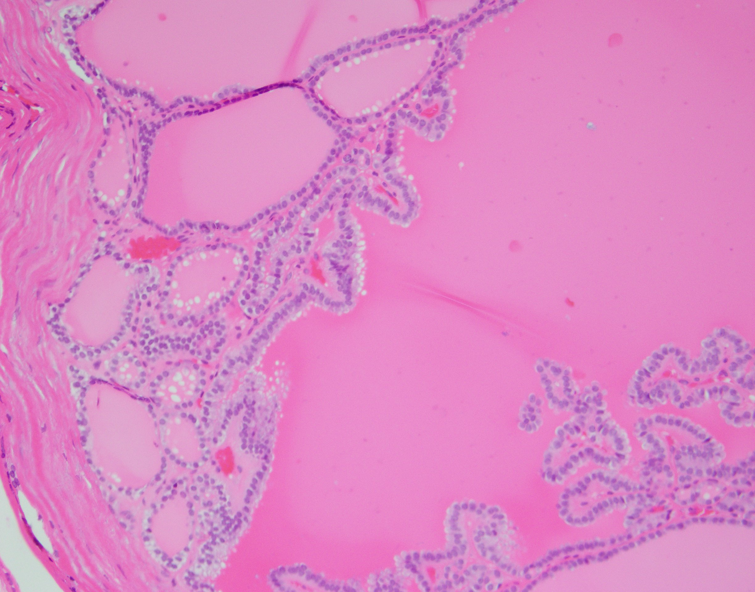
Follicular adenoma with papillary architecture

Slide 9
Follicular adenoma with papillary architecture
Definition
A benign non-invasive encapsulated follicular-cell-derived neoplasm that is characterized by an intrafollicular papillary architecture, lacks nuclear features of papillary thyroid carcinoma, and is often associated with autonomous hyperfunction (WHO 2022)

Slide 10
Follicular adenoma with papillary architecture
Etiology
Unknown
Few arise in the setting of thyroid follicular nodular disease
(multinodular goiter)
Most occur in patients with McCune Albright syndrome, Carney complex, PTEN-HTS, and DICER1 syndrome

Slide 11
Follicular adenoma with papillary architecture
Histopathology
These tumours have a characteristic morphology
They are usually cystic and show a mixture of follicular and papillary architecture that is neither random nor complex
Large follicles with complex papillary infoldings of the lining epithelium, with broad papillae showing an organized centripedal orientation

Slide 12
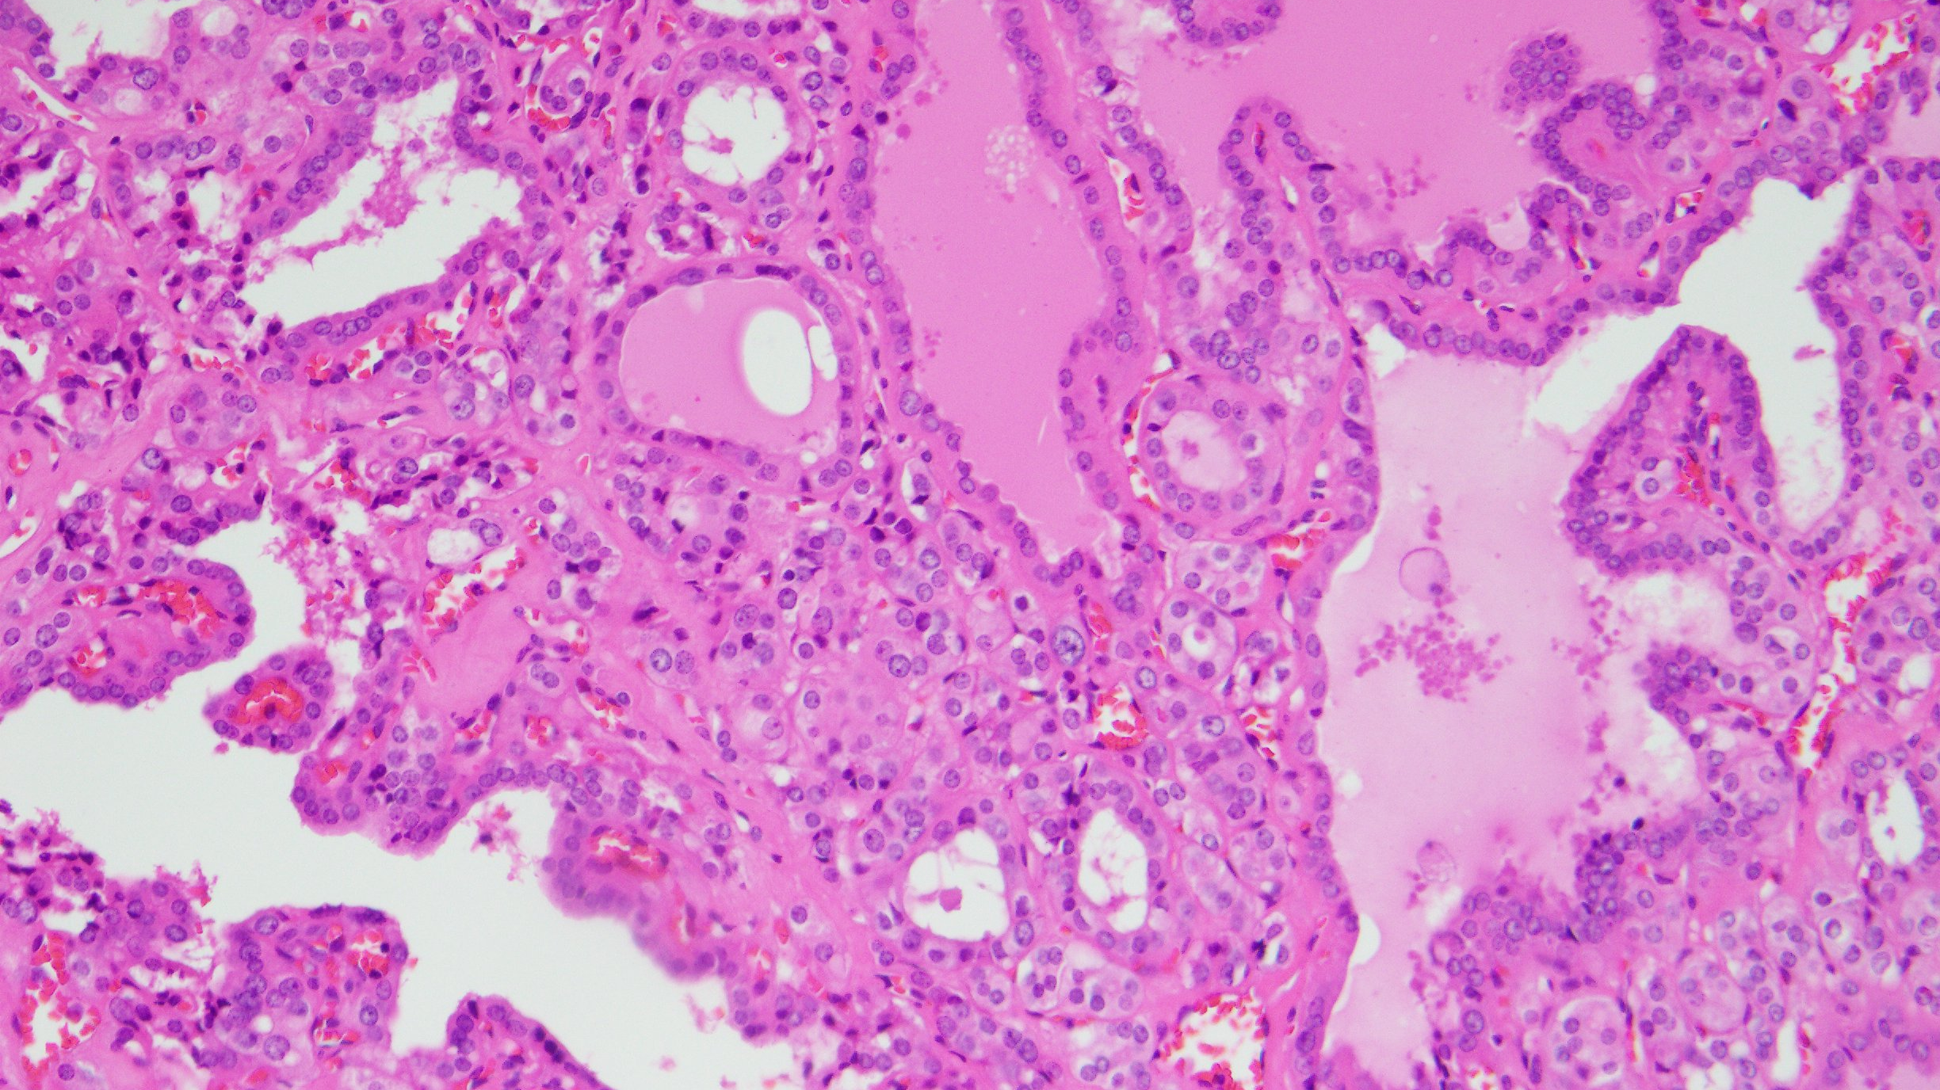
Notes:
DICER1 centripetal hyperplasia

Slide 13
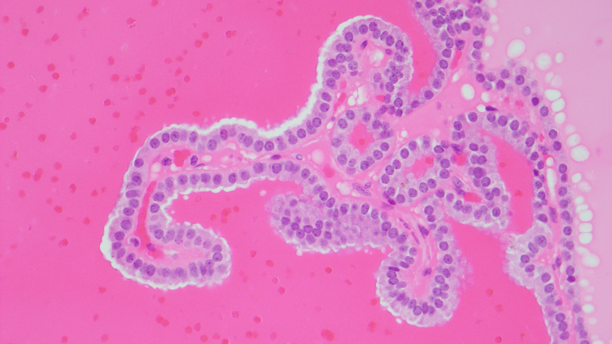

Slide 14
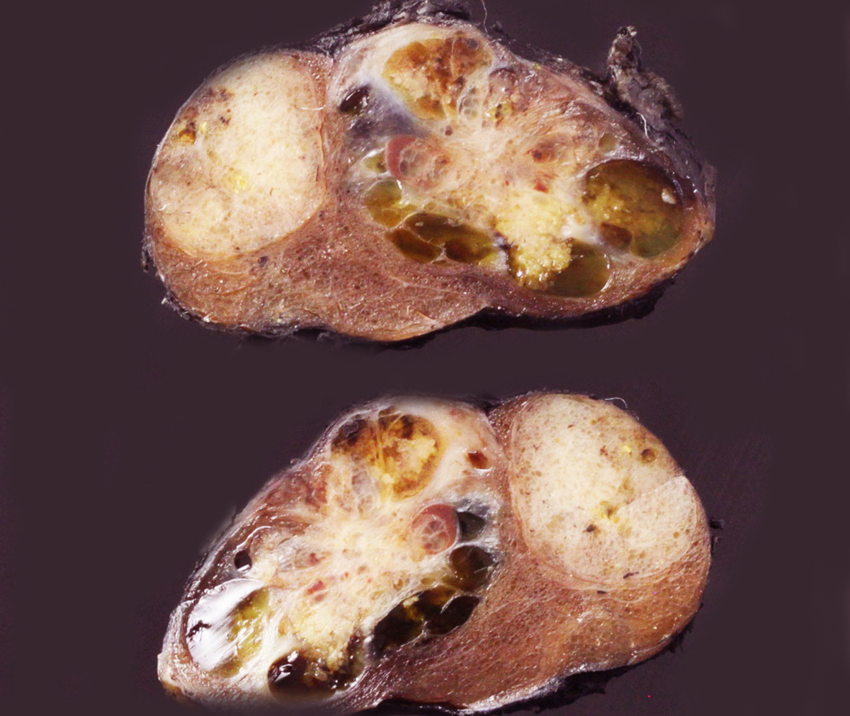
Thyroid Follicular Nodular Disease (FND)

Slide 15
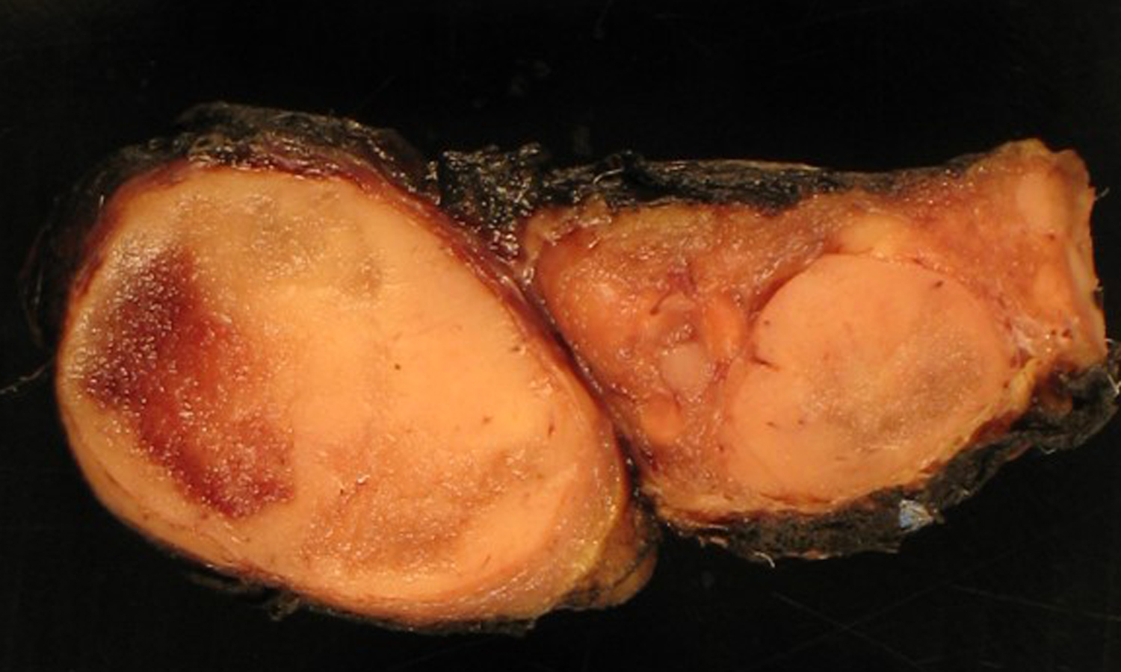

Slide 16
Thyroid Follicular Nodular Disease (FND)
Definition
Thyroid follicular nodular disease (FND) is a multifocal non-inflammatory benign proliferation of thyroid follicular cells that results in multiple clonal and non-clonal nodules with highly variable architecture.
Multinodular goiter (MNG) is clinical term referring to an enlarged thyroid

Slide 17
Thyroid Follicular Nodular Disease (FND)
Etiology
It is likely a multifactorial process which involves inherent predisposition (susceptibility to developing thyroid nodules, familial euthyroid goiter) and environmental factors
Iodine deficiency

Slide 18
Thyroid Follicular Nodular Disease (FND)
Pathogenesis
Follicular nodules in MNG develop due to the proliferation of multiple cells in response to growth factors and cytokines
Clonal nodules do occur in the background of MNG and represent true neoplasms
Familial and early-onset FND can also be associated with DICER1 syndrome
TSHR and GNAS, PRKAR1A (typically in the setting of Carney complex) and EZH1 mutations

Slide 19
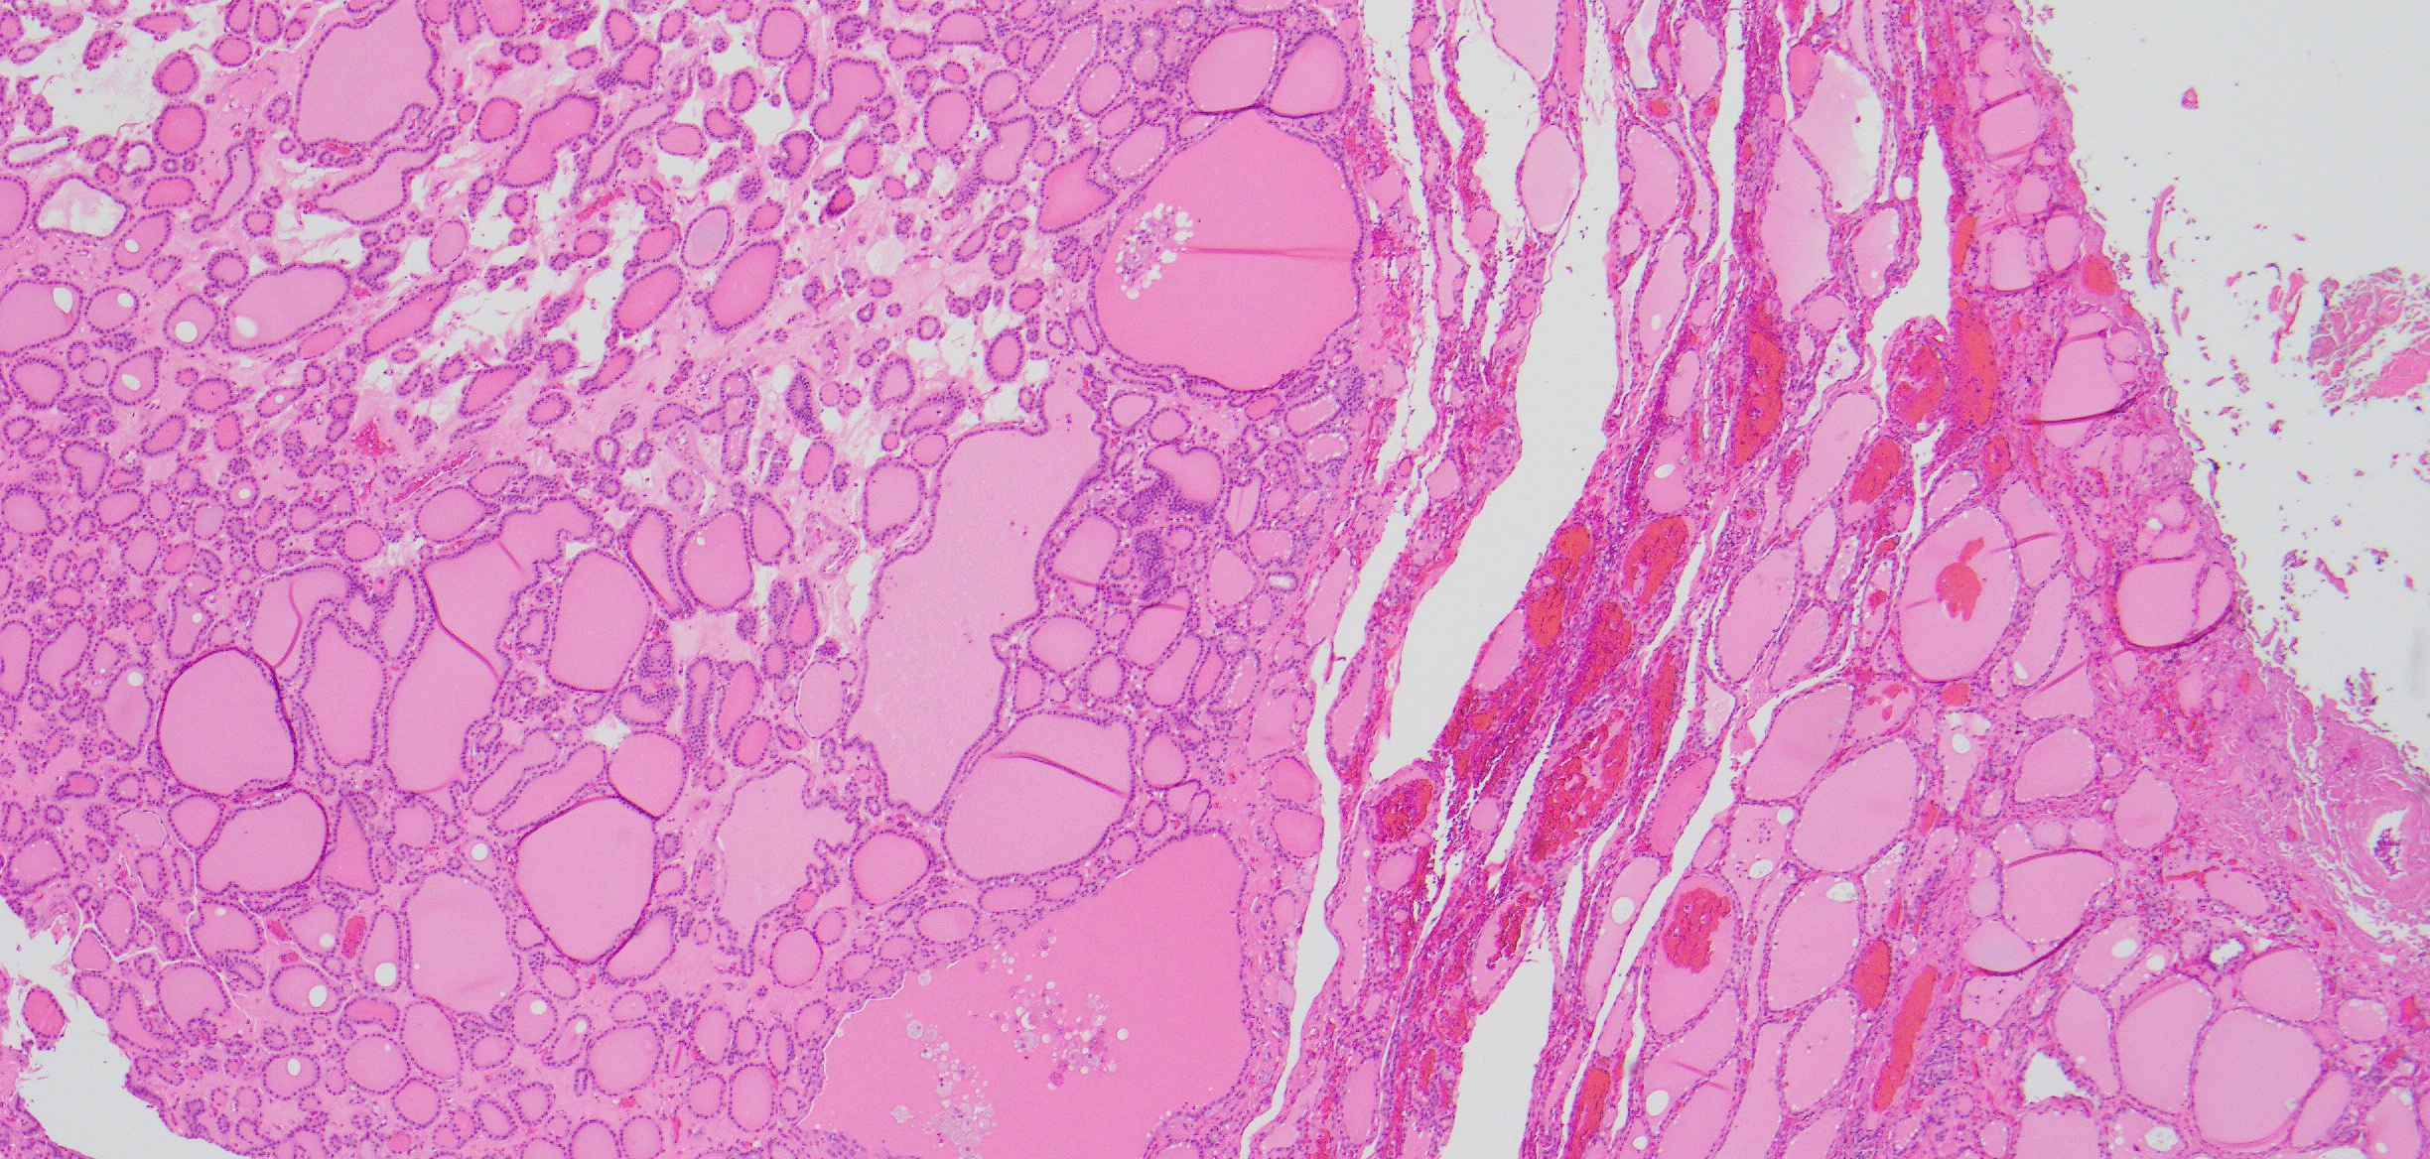

Slide 20
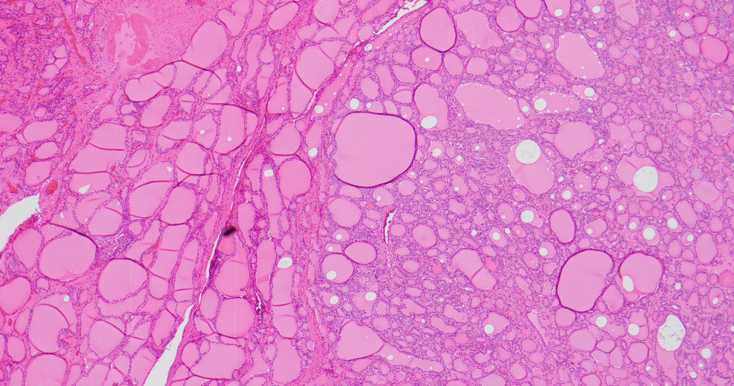

Slide 21
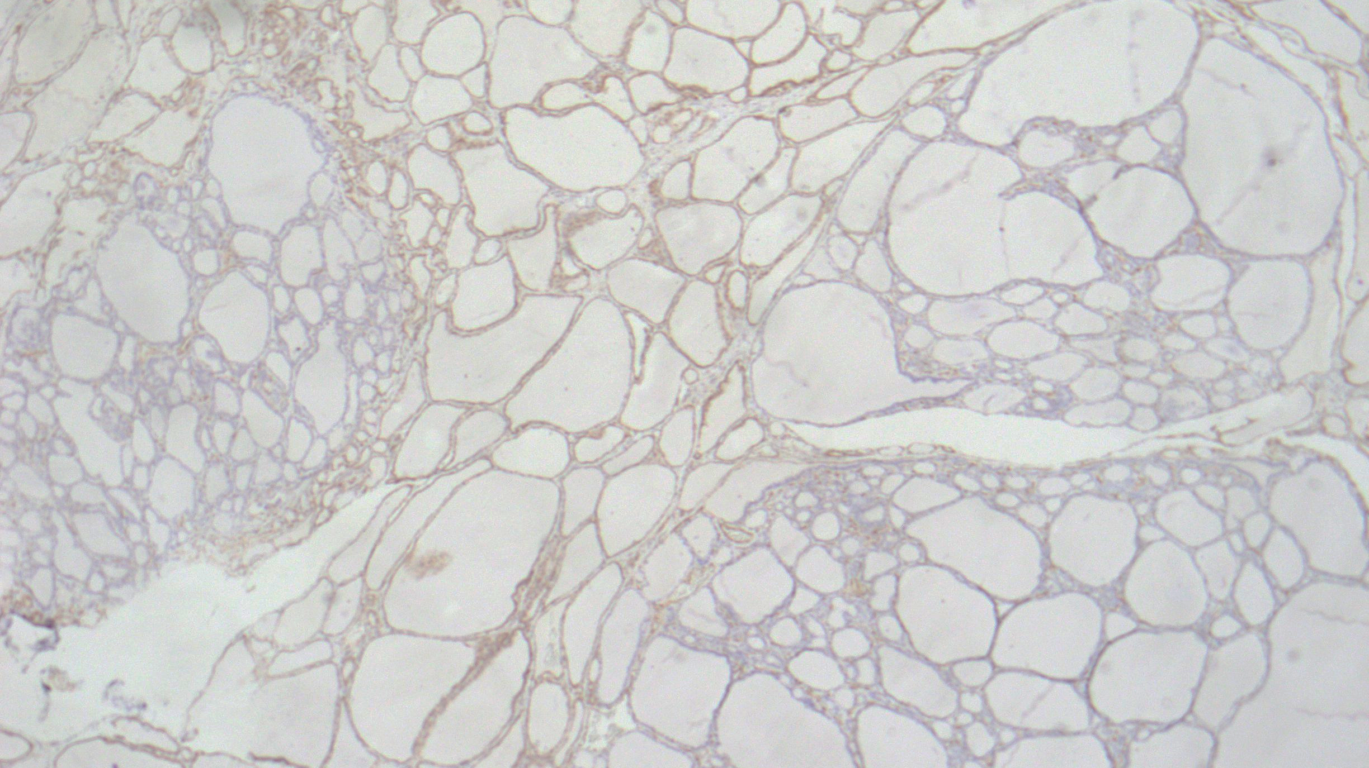
PTEN

Slide 22
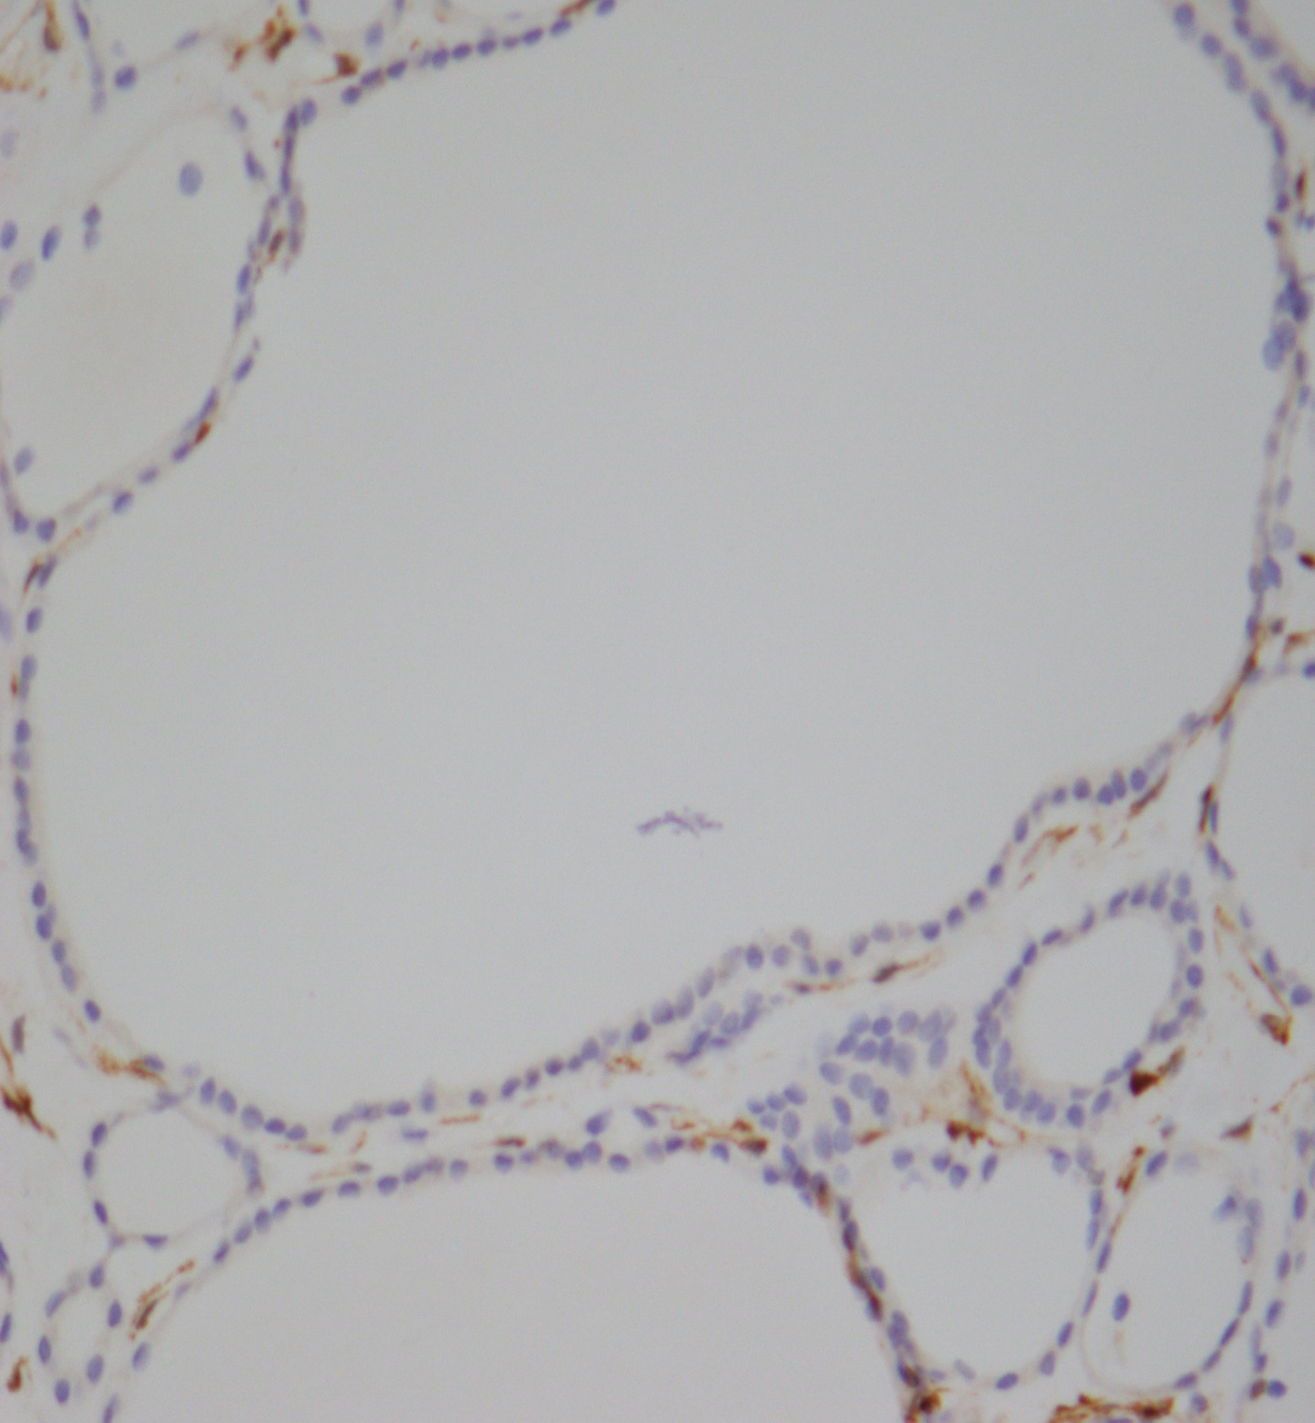
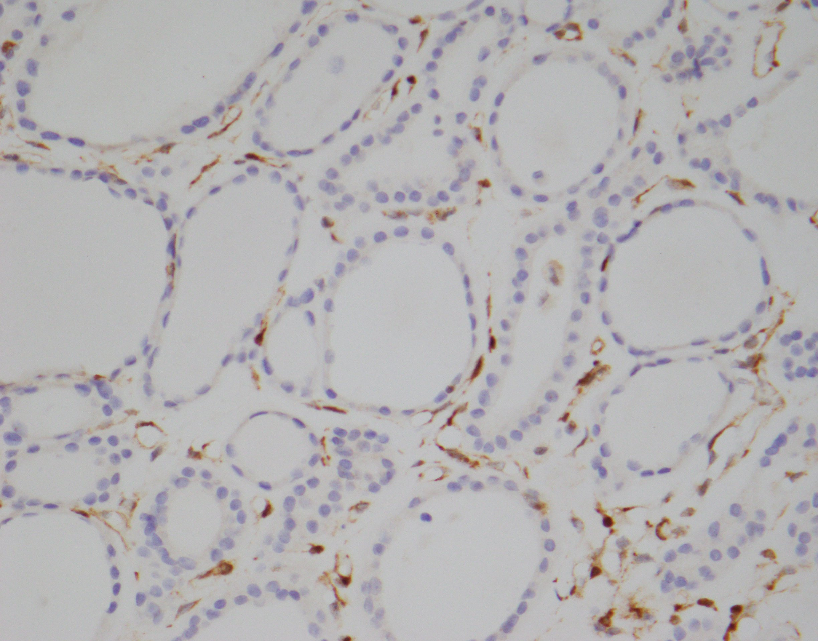

Slide 23
5th Edition WHO Classification of Endocrine and Neuroendocrine Tumors
Low-risk follicular cell-derived neoplasms include:
Non-invasive follicular thyroid neoplasm with papillary-like nuclear features (NIFTP)
Thyroid tumors of uncertain malignant potential
Hyalinizing trabecular tumor

Slide 24
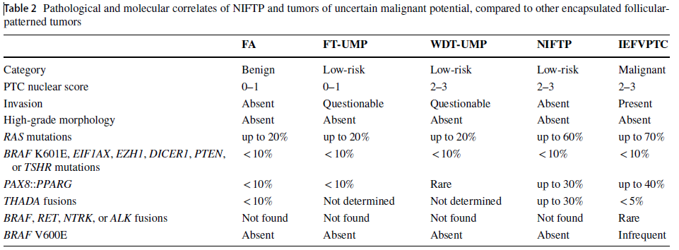

Slide 25
5th Edition WHO Classification of Endocrine and Neuroendocrine Tumors
Malignant follicular cell-derived neoplasms
Stratified based on molecular profiles and aggressiveness
Papillary thyroid carcinomas, and its morphological subtypes, represent the BRAF-like malignancies
Invasive encapsulated follicular variant PTC and follicular thyroid carcinoma represent the RAS-like malignancies

Slide 26
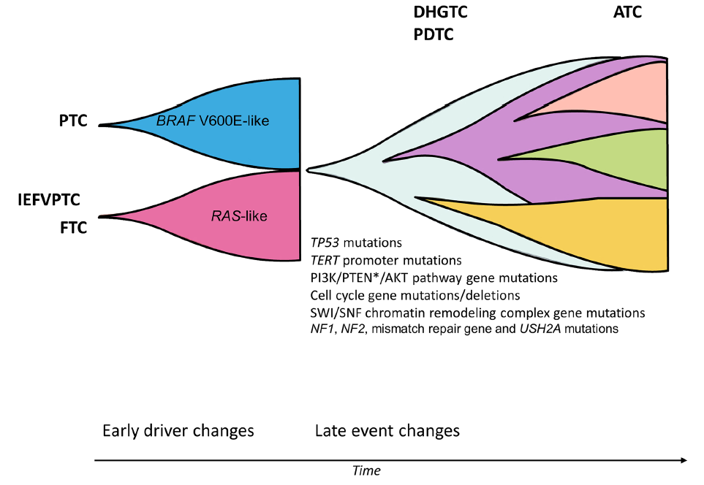
Schematic Overview of the Multistep Process of Thyroid Cancer Development and Progression

Slide 27
5th Edition WHO Classification of Endocrine and Neuroendocrine Tumors
High-grade follicular cell–derived malignancy includes:
Poorly differentiated carcinoma
High-grade differentiated thyroid carcinomas
  -Both are characterized by increased mitotic activity and tumor necrosis without anaplastic histology and clinically behave in a similar manner
Anaplastic thyroid carcinoma remains the most undifferentiated form
Squamous cell carcinoma of the thyroid is now considered as a subtype of anaplastic carcinoma

Slide 28
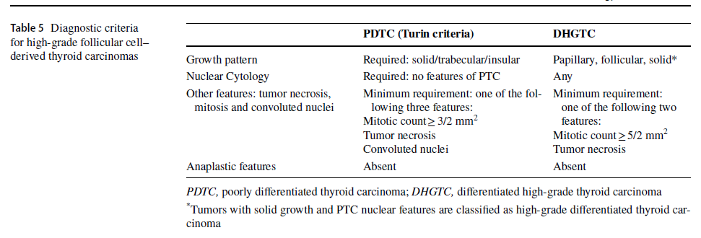
High-grade Differentiated Thyroid Carcinoma

Slide 29
Histologic Criteria for DHGTC
Invasive
Subclassified according to dominant differentiated histotype: FTC, OTC, PTC
  Most are PTC with high-grade features
> 5 mitoses per 2 mm²
Tumor necrosis
Lack anaplastic morphology

Slide 30
Histologic Criteria for PDTC
Invasive malignant follicular neoplasm
Solid, trabecular or insular growth pattern
Absence of conventional nuclear features of papillary carcinoma
Presence of at least one of the following:
  Convoluted nuclei
  Mitotic activity > 3 per 2 mm²
  Tumor Necrosis
Absence of anaplastic morphology

Slide 31
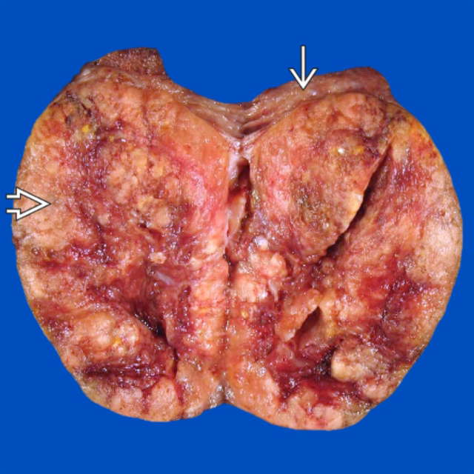

Slide 32
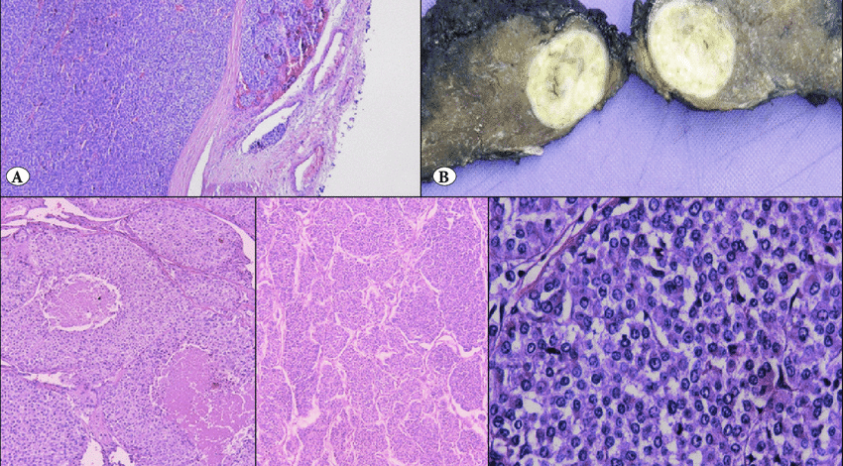

Slide 33
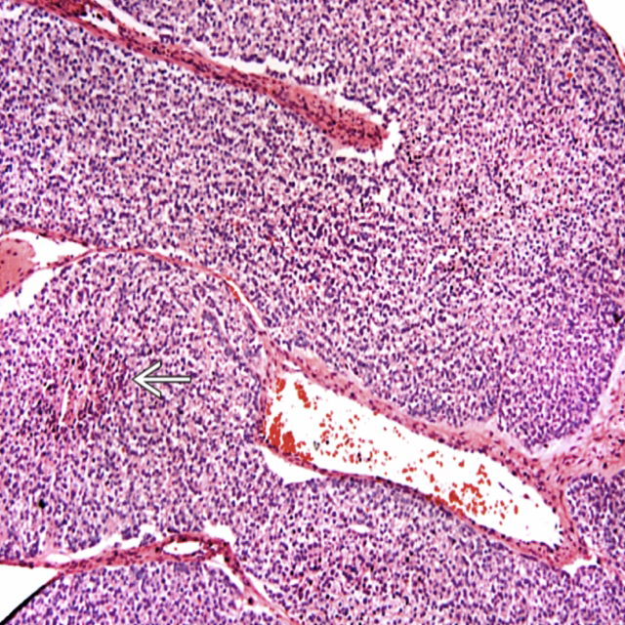

Slide 34
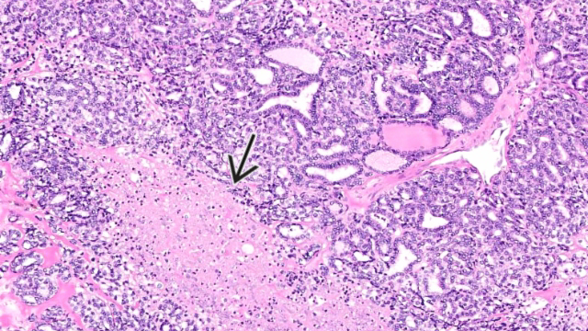

Slide 35
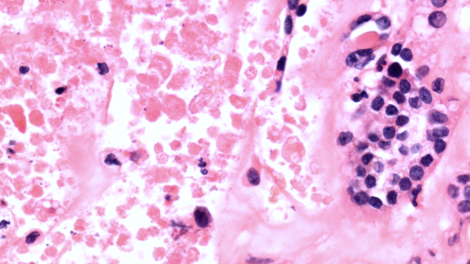

Slide 36
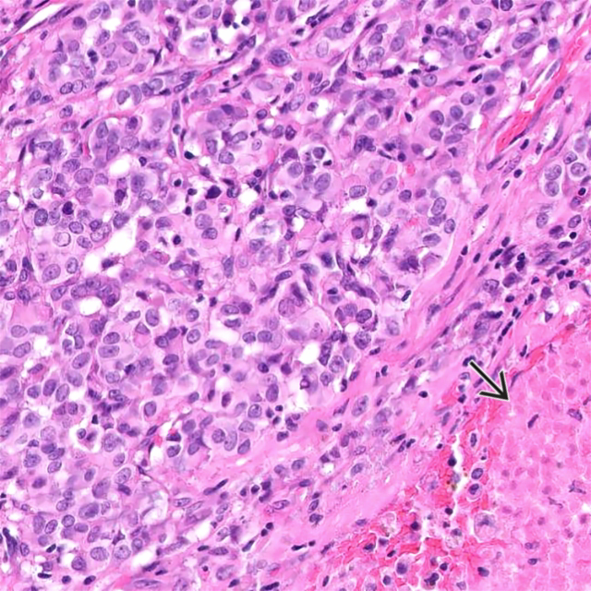

Slide 37
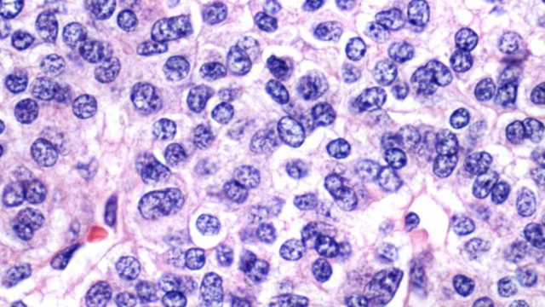

Slide 38
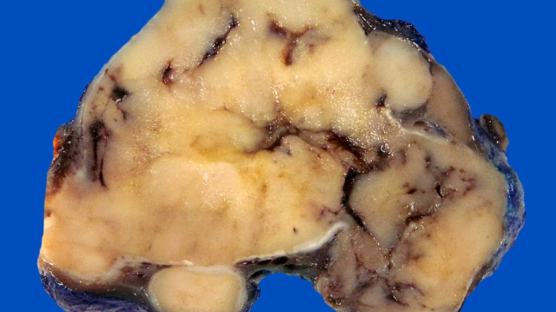

Slide 39
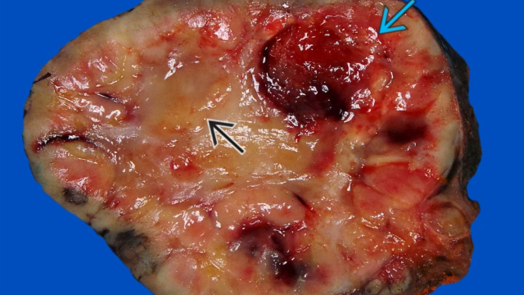

Slide 40
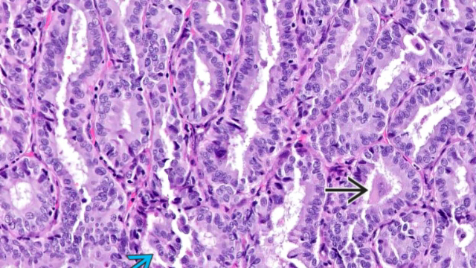

Slide 41
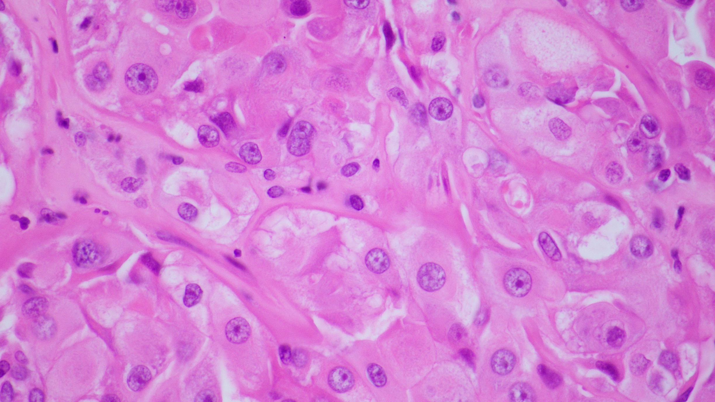
Notes:
S21 43121

Slide 42
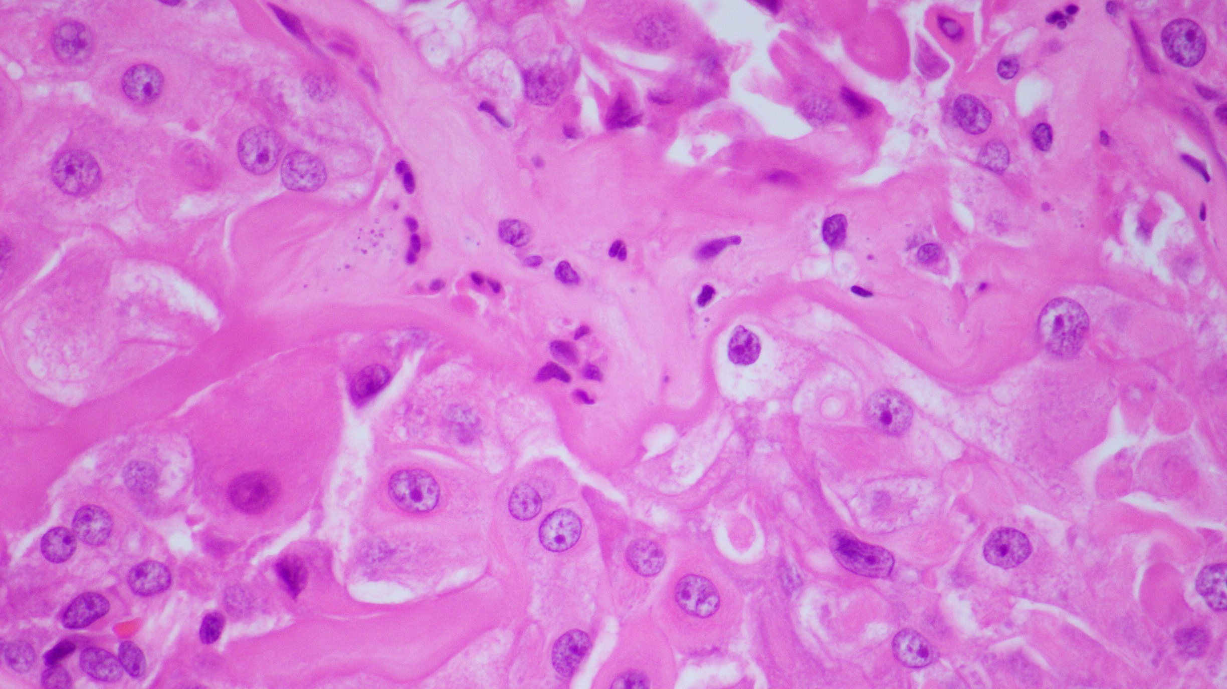
Notes:
S21 43121

Slide 43
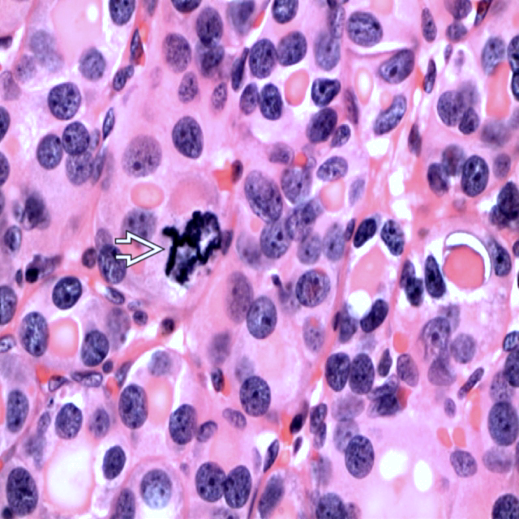

Slide 44
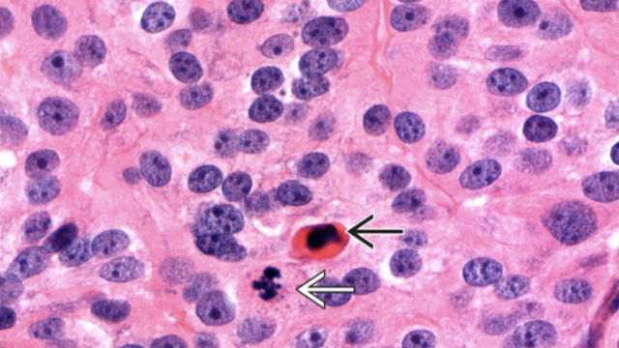

Slide 45
Immunohistochemistry
Usually retain markers of thyroid follicular cell differentiation
Keratin, PAX8, TTF-1
Thyroglobulin may be reduced
p53 may be positive but is not diagnostic
Neuroendocrine markers and calcitonin negative
Ki-67 proliferation index increased (10-30%)

Slide 46
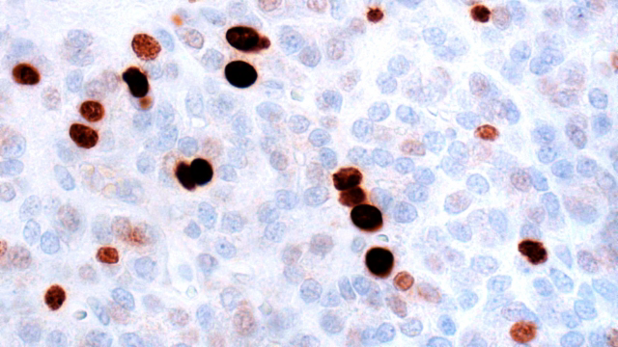

Slide 47
Turin Criteria for Diagnosis of Poorly Differentiated Thyroid Carcinoma
  Invasive carcinoma with
    Presence of solid, trabecular, or insular patterns of growth
      Solid: Wide sheets of cells with little intervening stroma
      Trabecular: Cells arranged in long, wide ribbons or cords separated by stroma
      Insular: Cells arranged in rounded groups separated by thin, fibrovascular septa
    Absence of classic nuclear features of PTC
    Presence of at least 1 of following
      Mitotic activity ≥ 3/2 mm² (depending on diameter of objective lens, may be 8-10 HPF)
      Tumor necrosis
      Convoluted nuclei
  Moderate nuclear pleomorphism is allowed but must not reach anaplastic state
    However, may develop into anaplastic thyroid carcinoma
  Preexisting well-differentiated carcinoma may be present
    More often FTC or OnTC than PTC
  Clear, mucinous, signet-ring, or rhabdoid differentation may be seen

Slide 48
Criteria for Diagnosis of Differentiated High-Grade Thyroid Carcinoma
Invasive carcinoma with
  Retention of architectural/cytologic features of well-differentiated carcinoma (PTC, FTC, OnTC)
  Presence of at least 1 of following
    Mitotic activity ≥ 5/2 mm²
    Tumor necrosis
Moderate nuclear pleomorphism is allowed but must not reach anaplastic state
  However, may develop into anaplastic thyroid carcinoma
Preexisting well-differentiated carcinoma may be present
  More often PTC than FTC or OnTC

Slide 49
Genetic Tests:
High-grade thyroid carcinomas have mutational burden intermediate between that of anaplastic and well-differentiated carcinoma
  Multiple genetic hits model: Many cases follow multistep progression from well-differentiated to high-grade carcinoma
Early driver events in thyroid carcinogenesis
  RAS-like signature, including HRAS, KRAS, or NRAS mutations (more common in PDTC)
  BRAF-like signature, including BRAF V600E mutation or gene fusions (more common in DHGTC)

Slide 50
Genetic Tests:
High Grade Thyroid Carcinomas
Late events in high-grade transformation
  TP53 mutation (also common in anaplastic)
  TERT promoter mutation (high risk of distant metastasis)
  PI3K/PTEN/AKT pathway alterations
  Chromosome 1q gain (unfavorable outcome)
  SWI/SNF (switch/sucrose nonfermentable) chromatin remodeling complex gene alterations (more common in anaplastic)

Slide 51
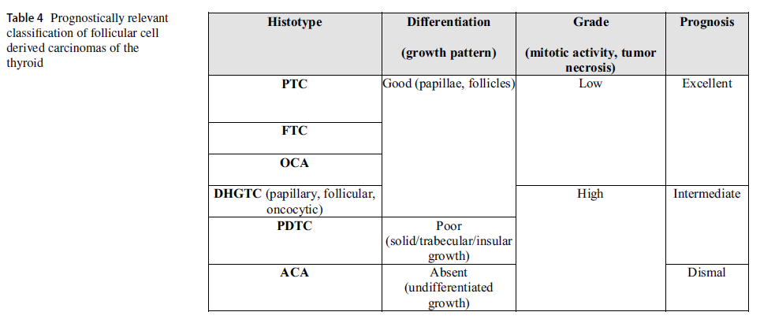

Slide 52
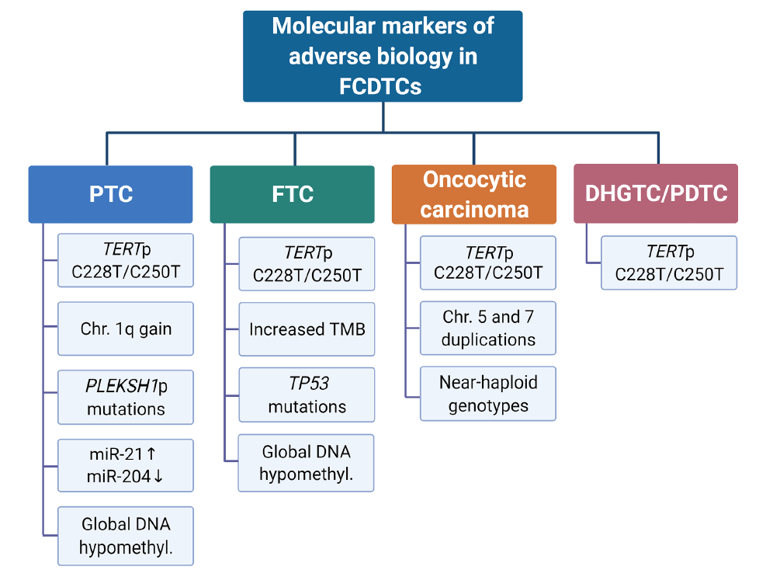

Slide 53
5th Edition WHO Classification of Endocrine and Neuroendocrine Tumors
A number of unusual neoplasms that occur in the thyroid have been placed into new sections based on their cytogenesis

Slide 54
2022 WHO Endocrine And Neuroendocrine Tumors: Thyroid
5. Salivary gland-type carcinomas of the thyroid
Mucoepidermoid carcinoma of the thyroid
Secretory carcinoma of salivary gland type
6. Thyroid tumors of uncertain histogenesis
Sclerosing mucoepidermoid carcinoma with eosinophilia
Cribriform morular thyroid carcinoma

Slide 55
2022 WHO Endocrine And Neuroendocrine Tumors: Thyroid
7. Thymic tumors within the thyroid
Thymoma family
Spindle epithelial tumour with thymus-like elements
Thymic carcinoma family
8. Embryonal thyroid neoplasms
Thyroblastoma

Slide 56
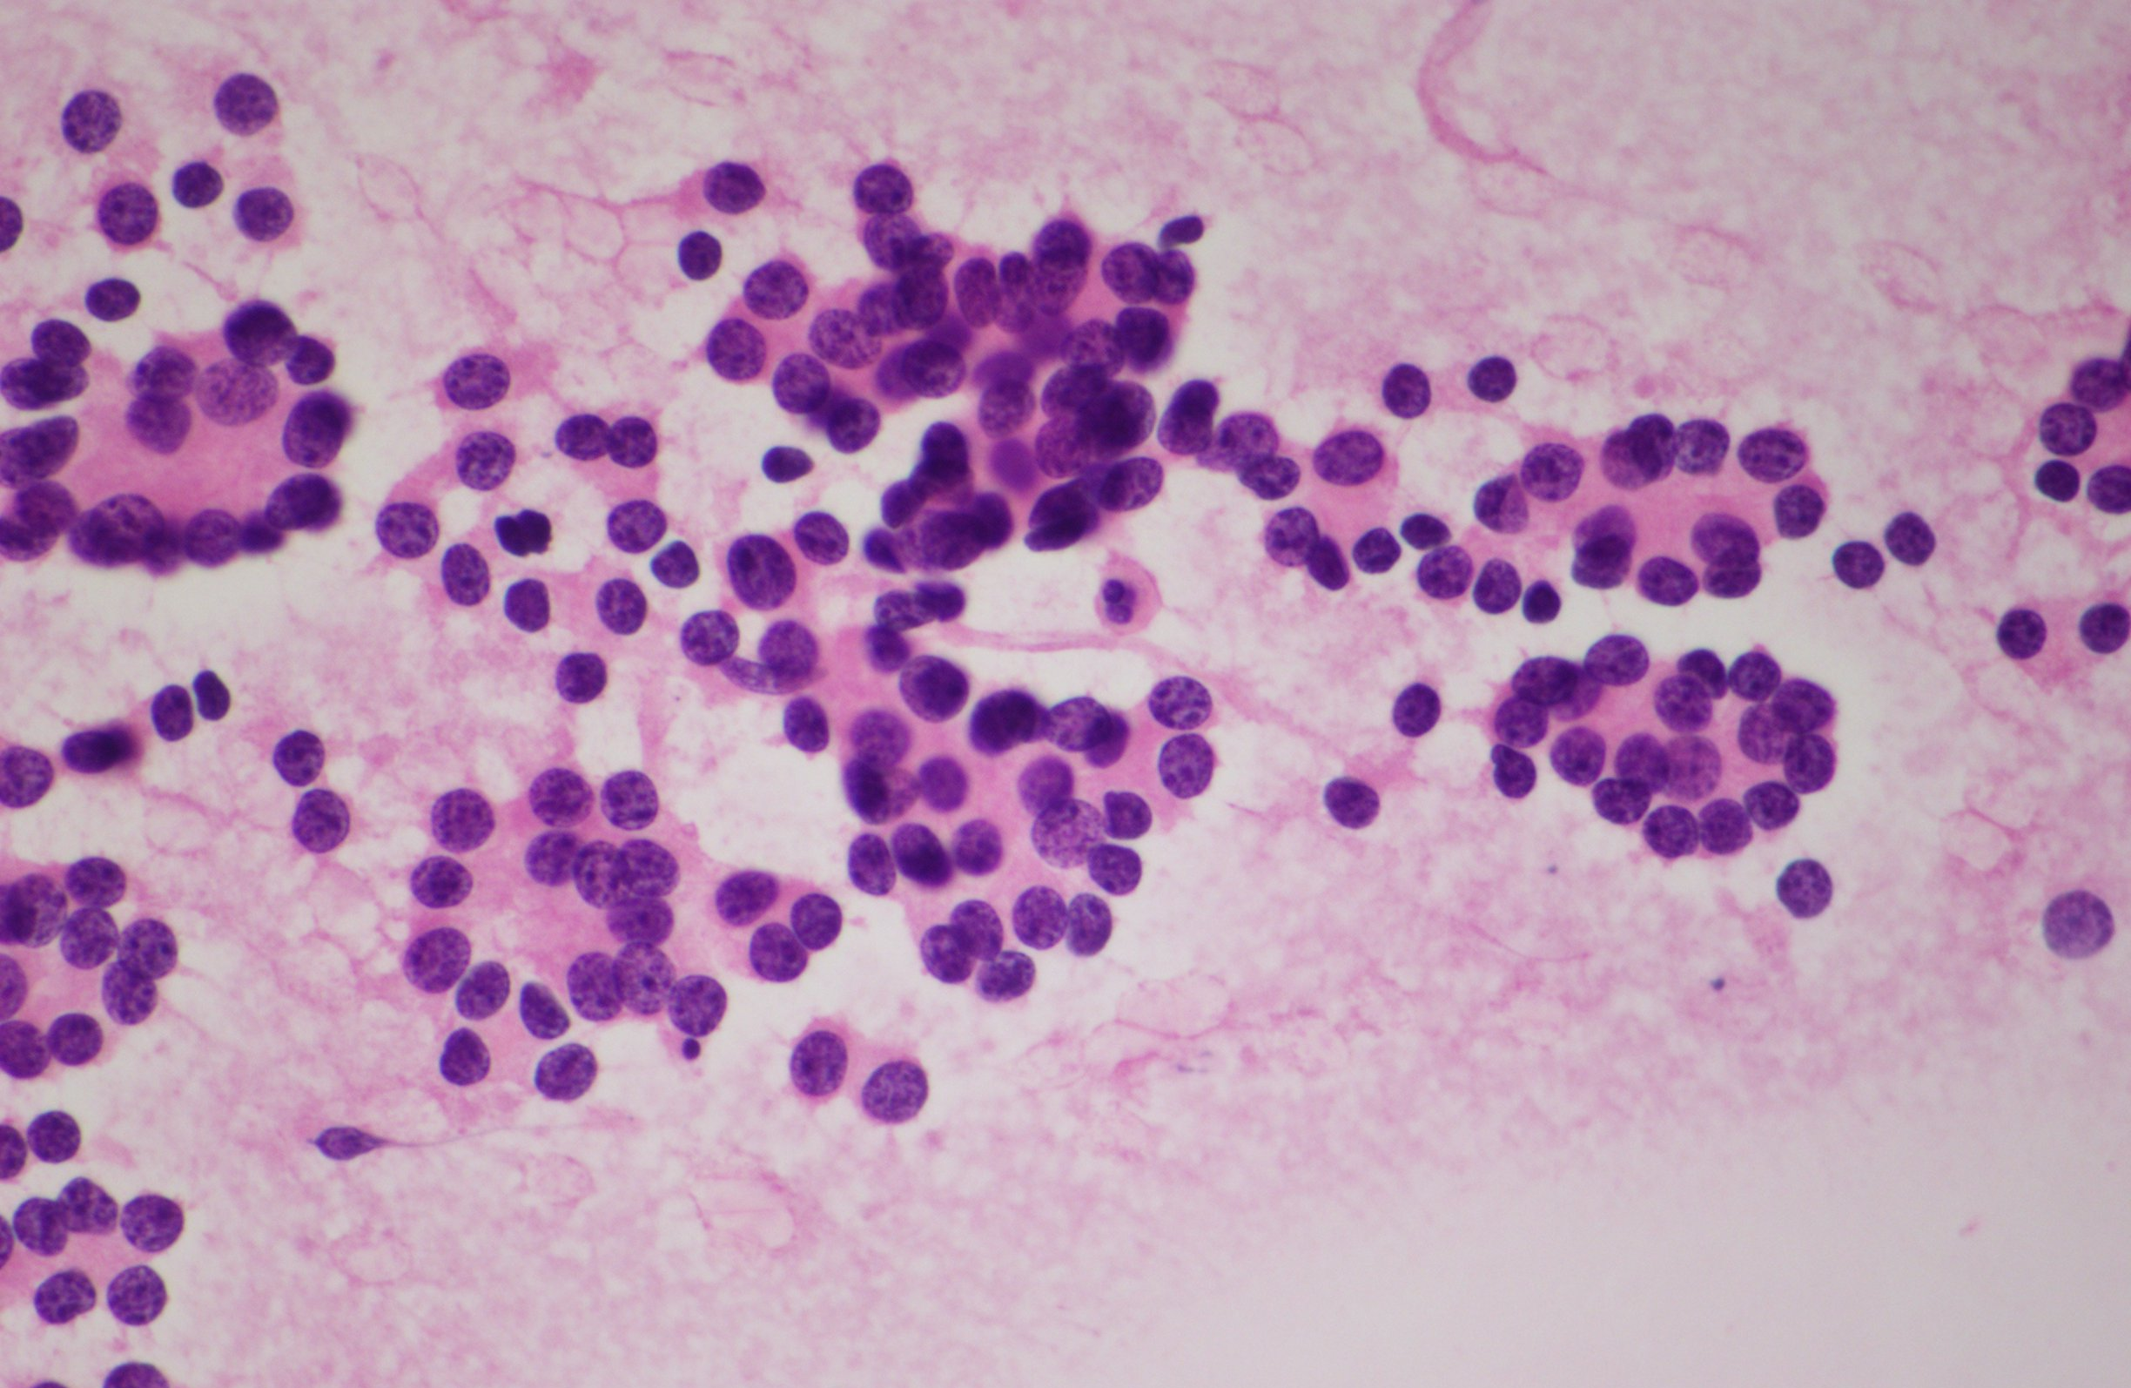
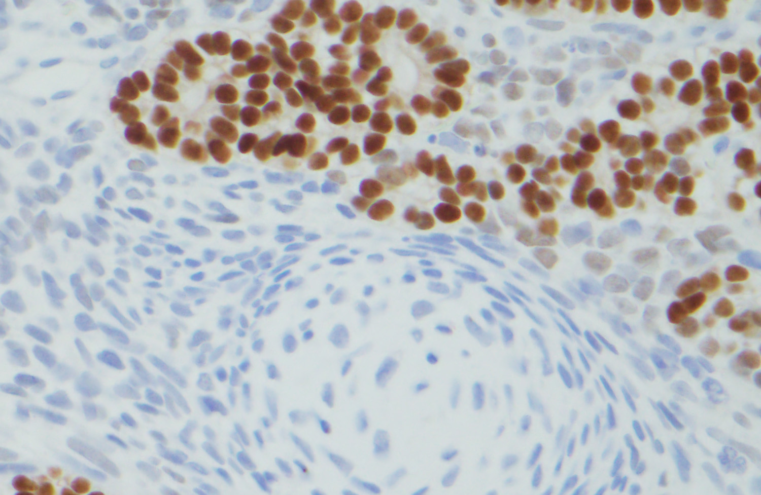
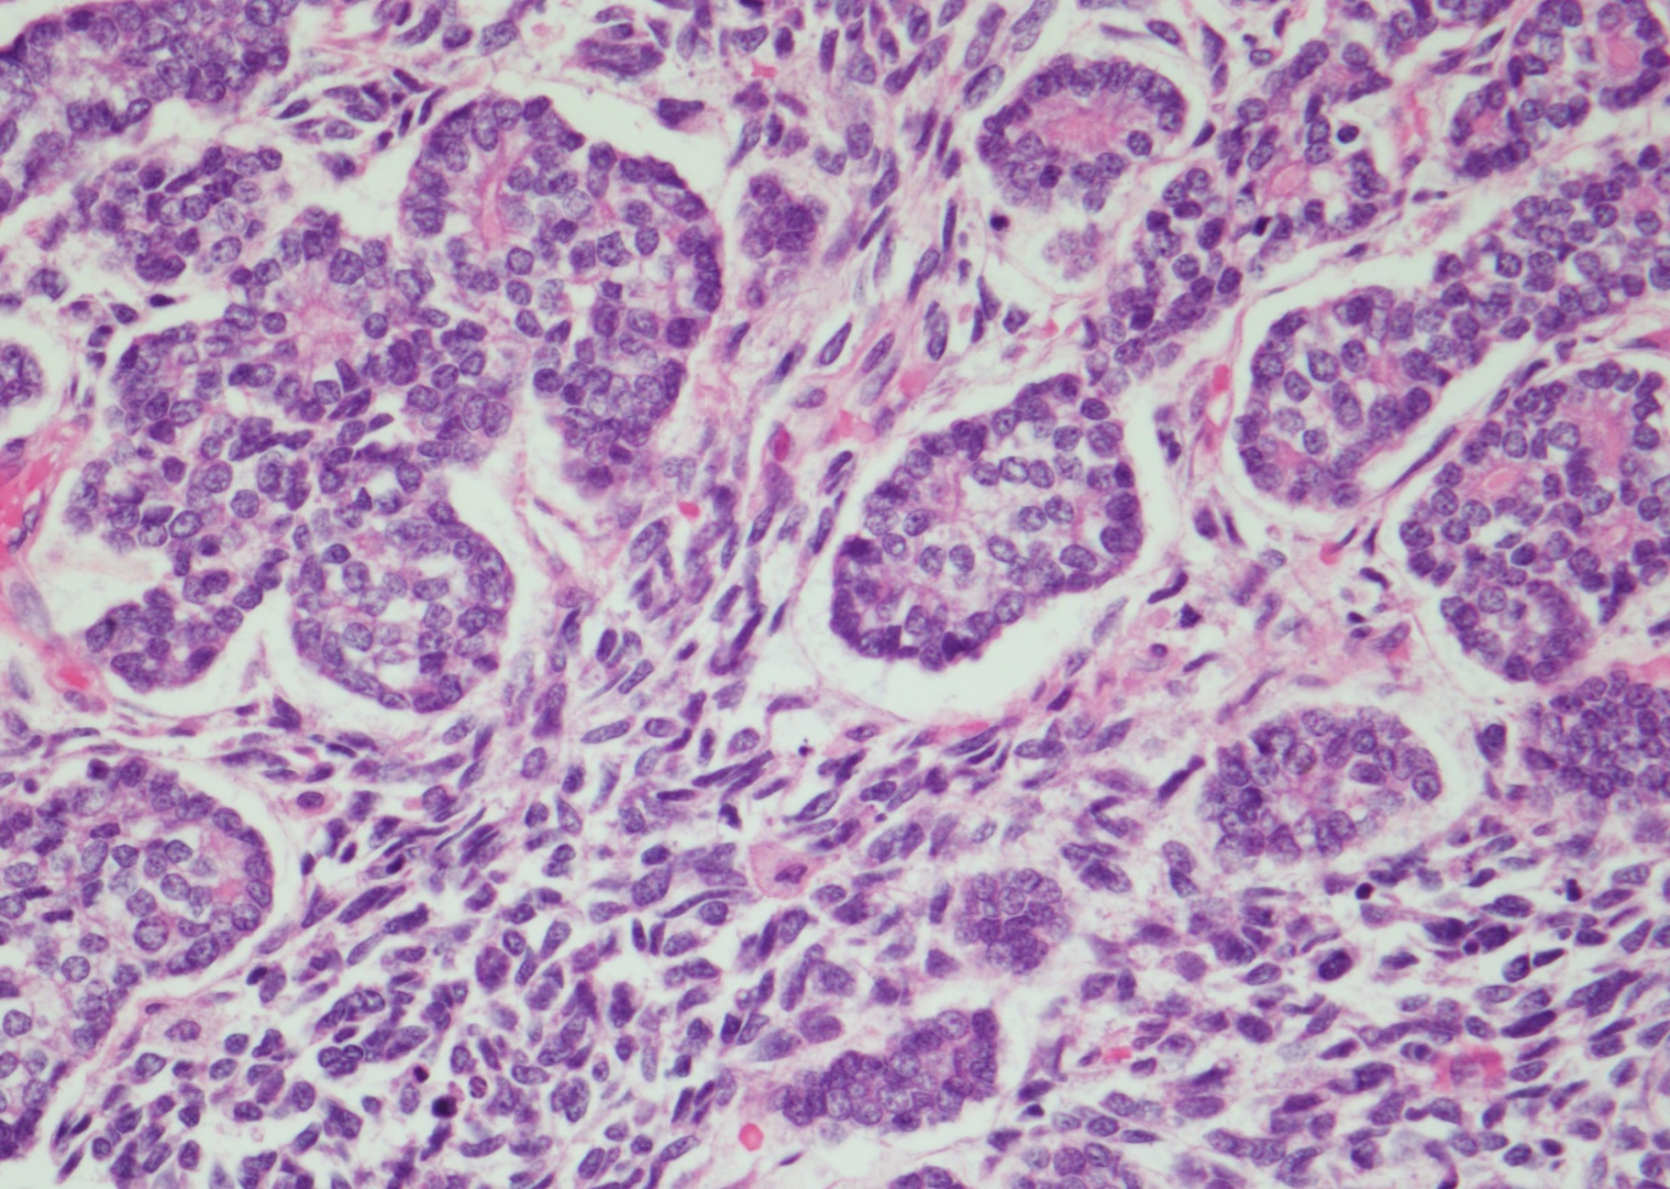
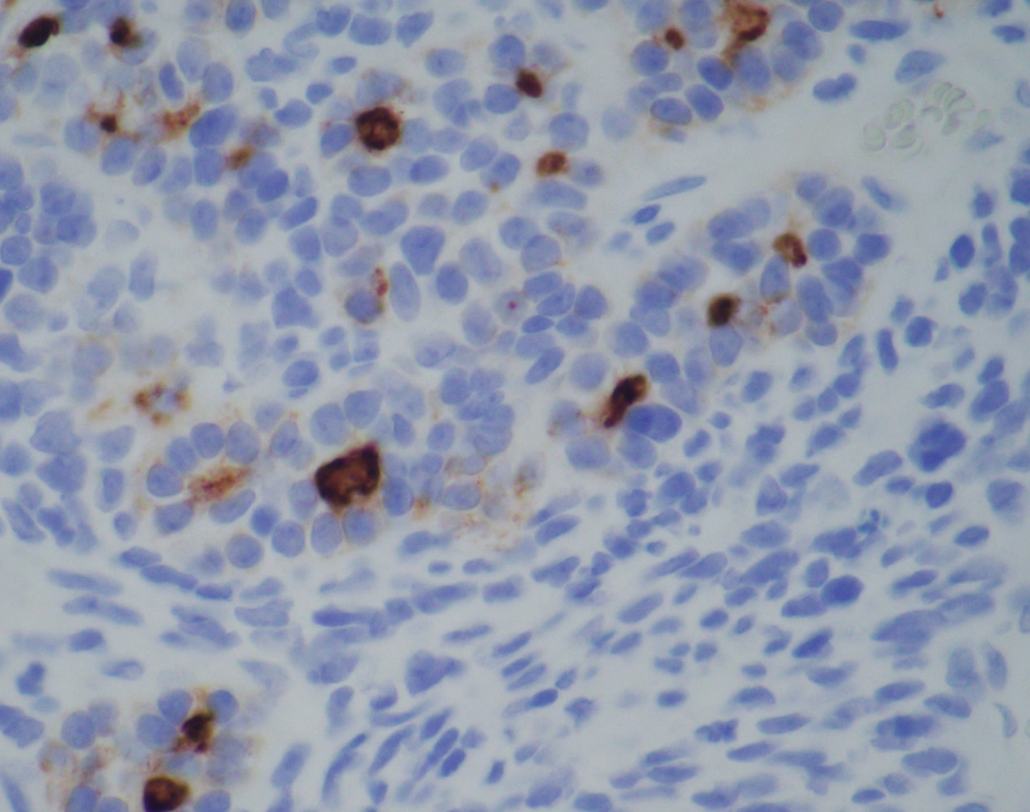
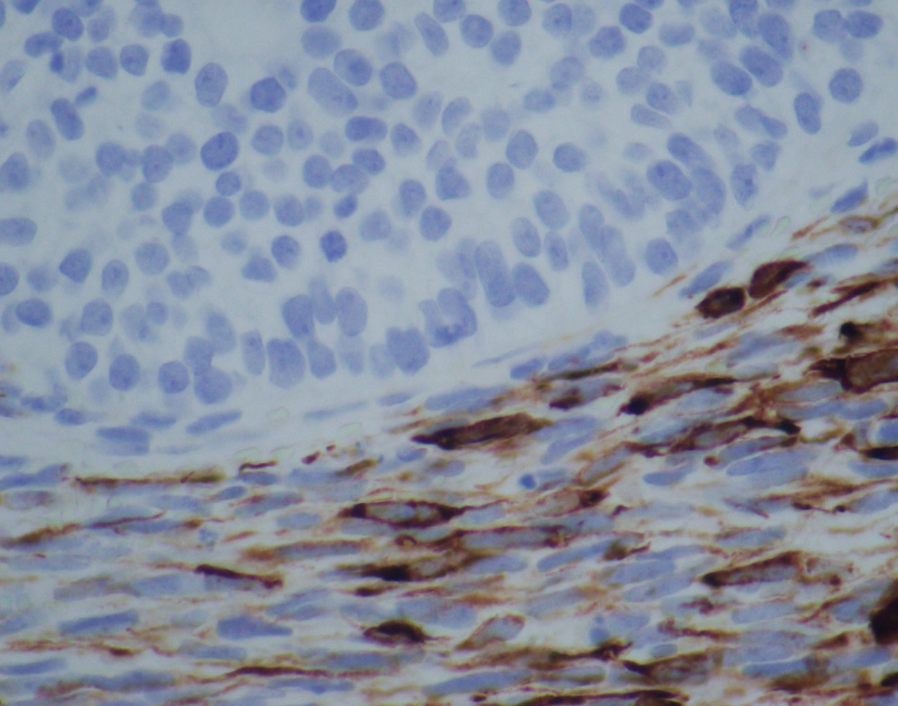
PAX8
Desmin
Thyroglobulin

Slide 57
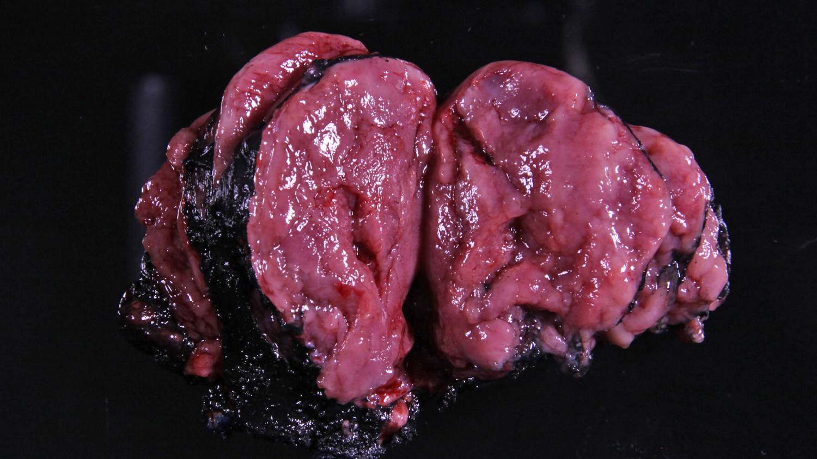
Thyroblastoma

Slide 58
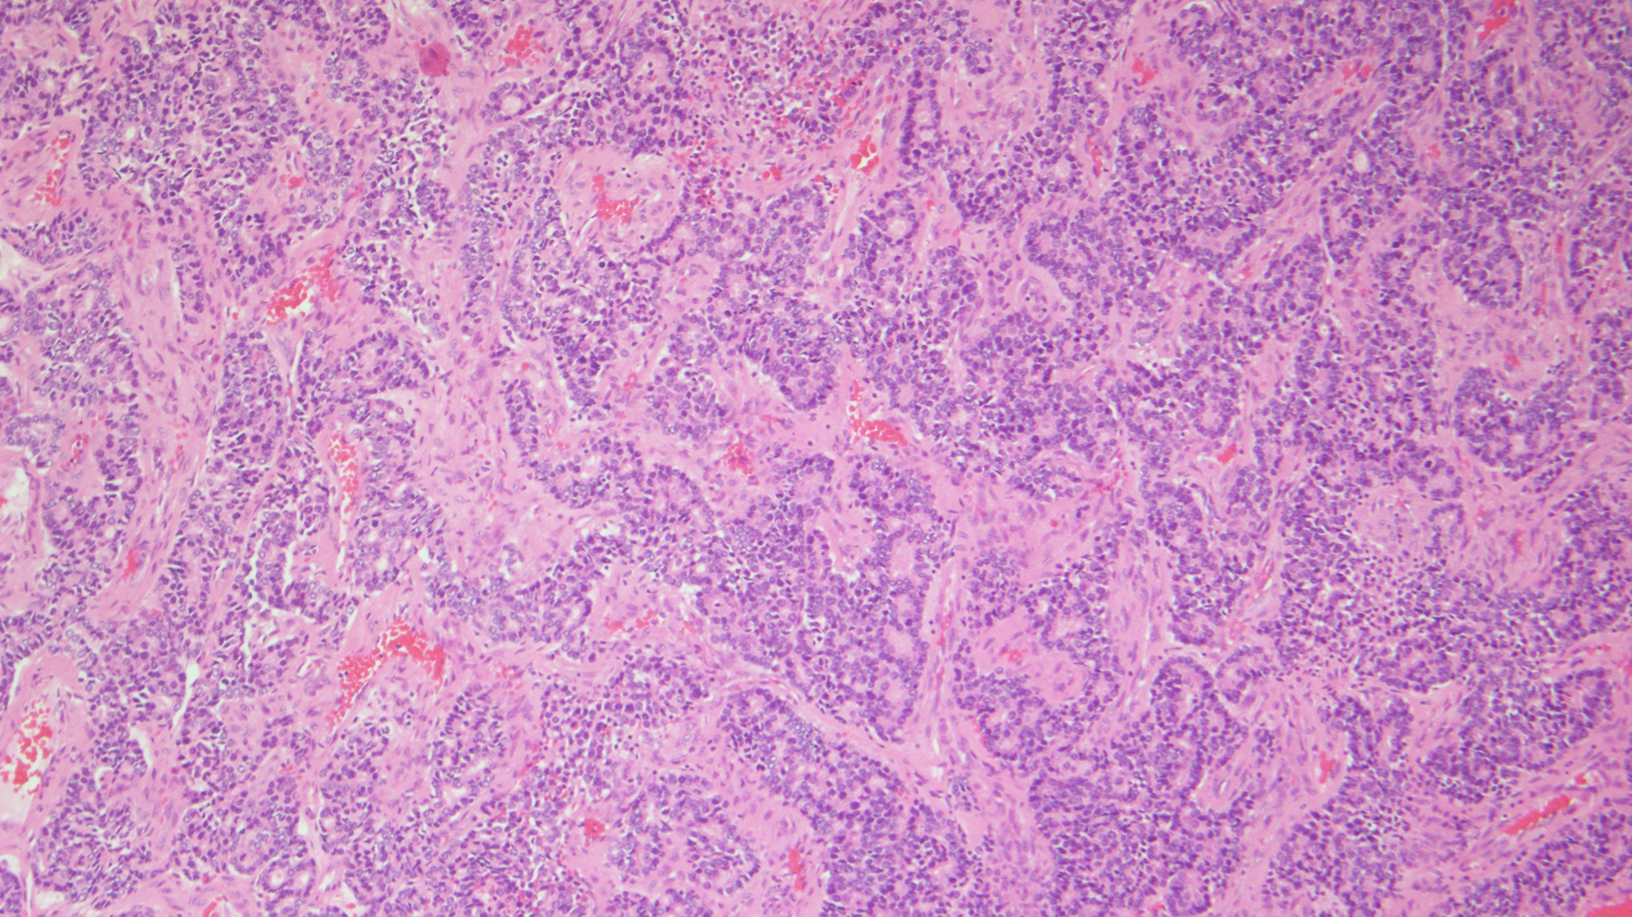
Fetal-type primitive-appearing thyroid follicles and fetal-type glands
Primitive spindle cell stroma

Slide 59
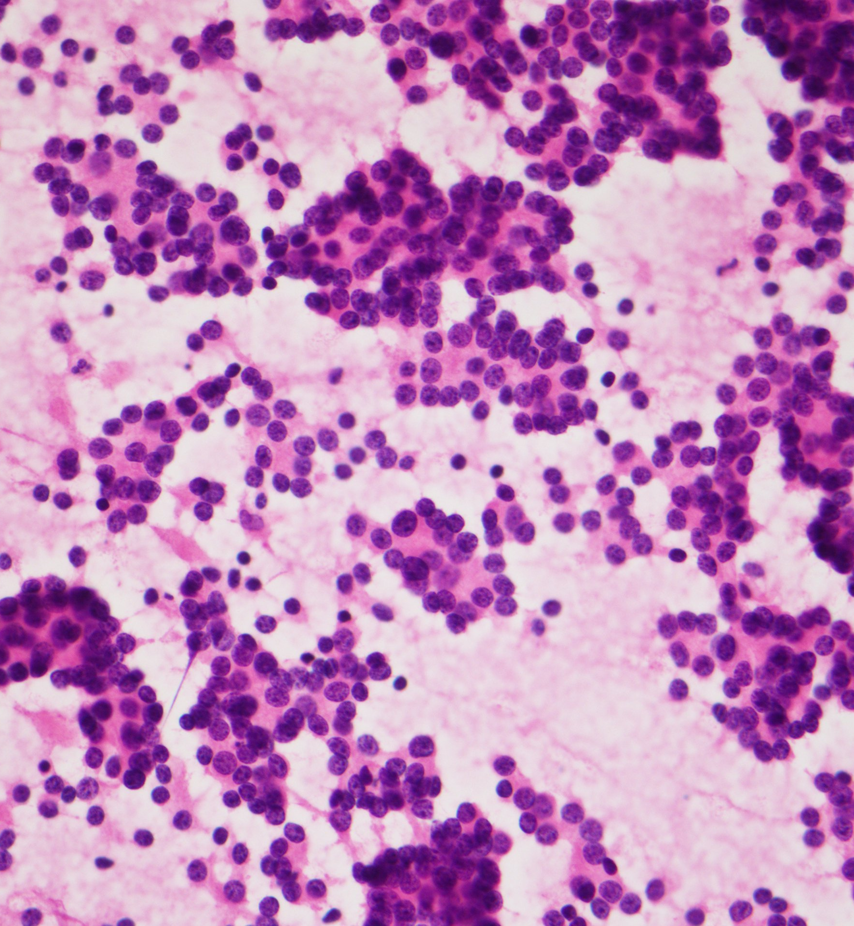
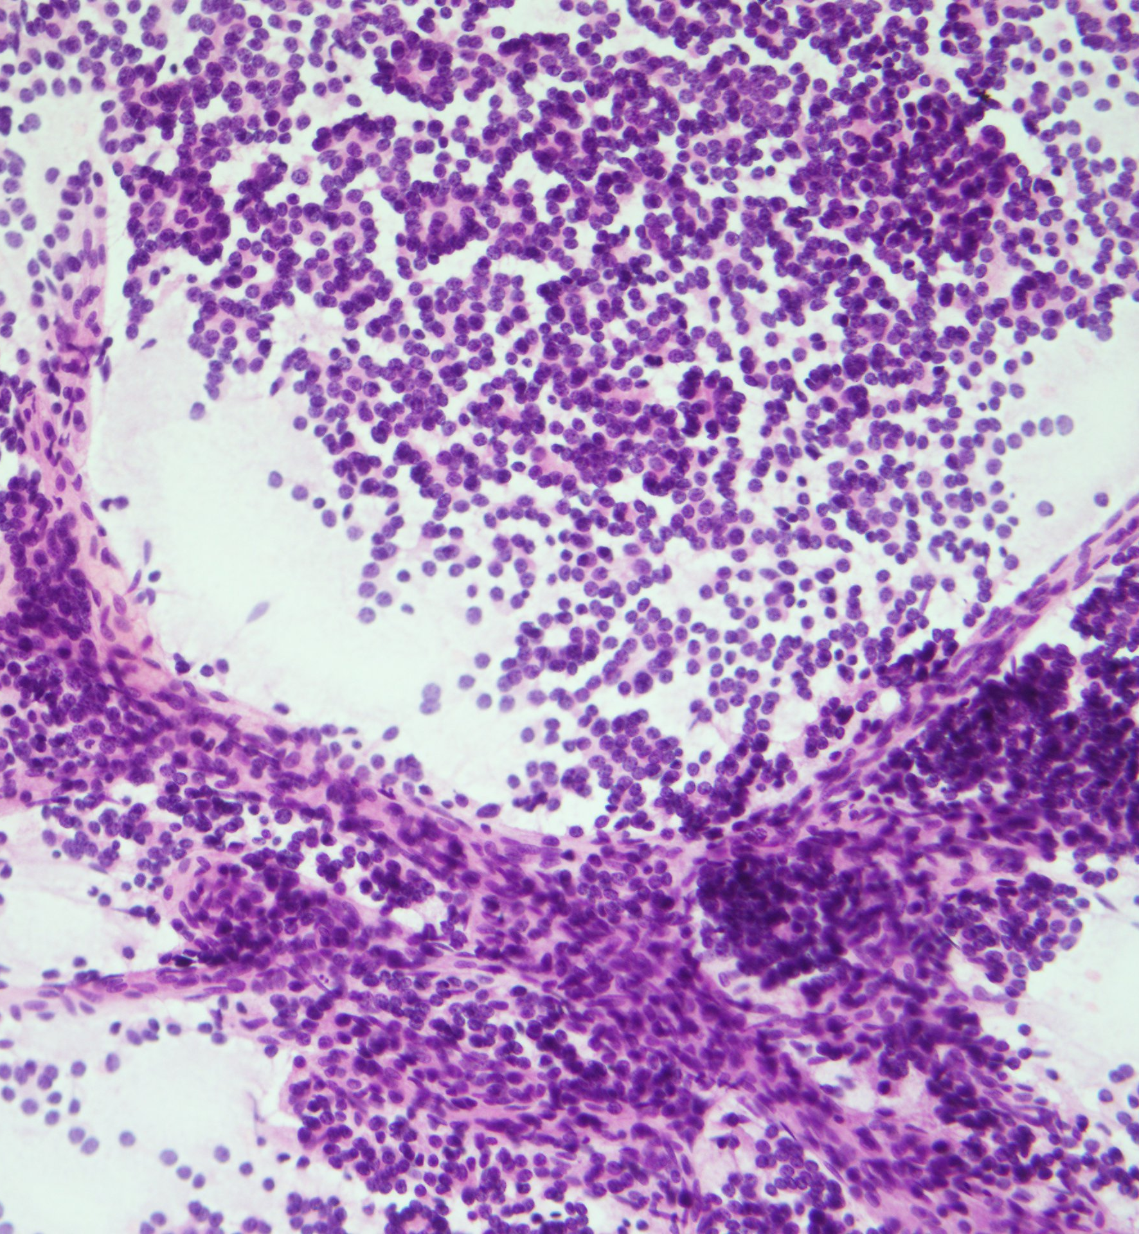
TP and Smear

Slide 60
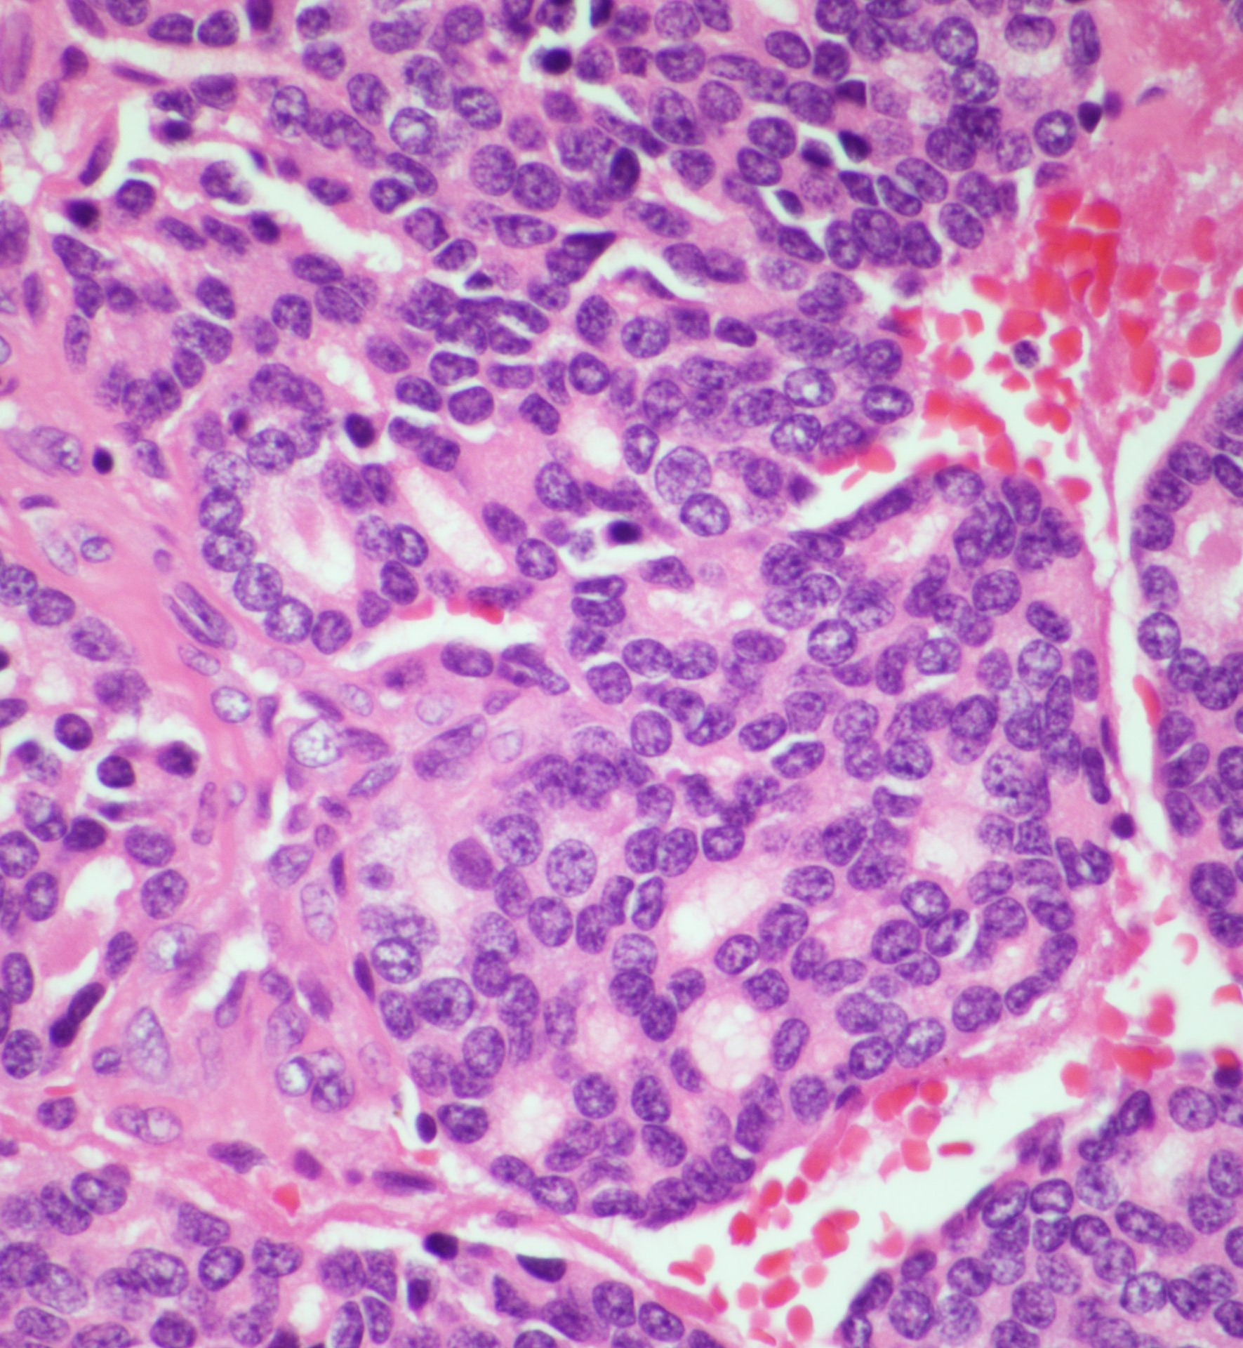
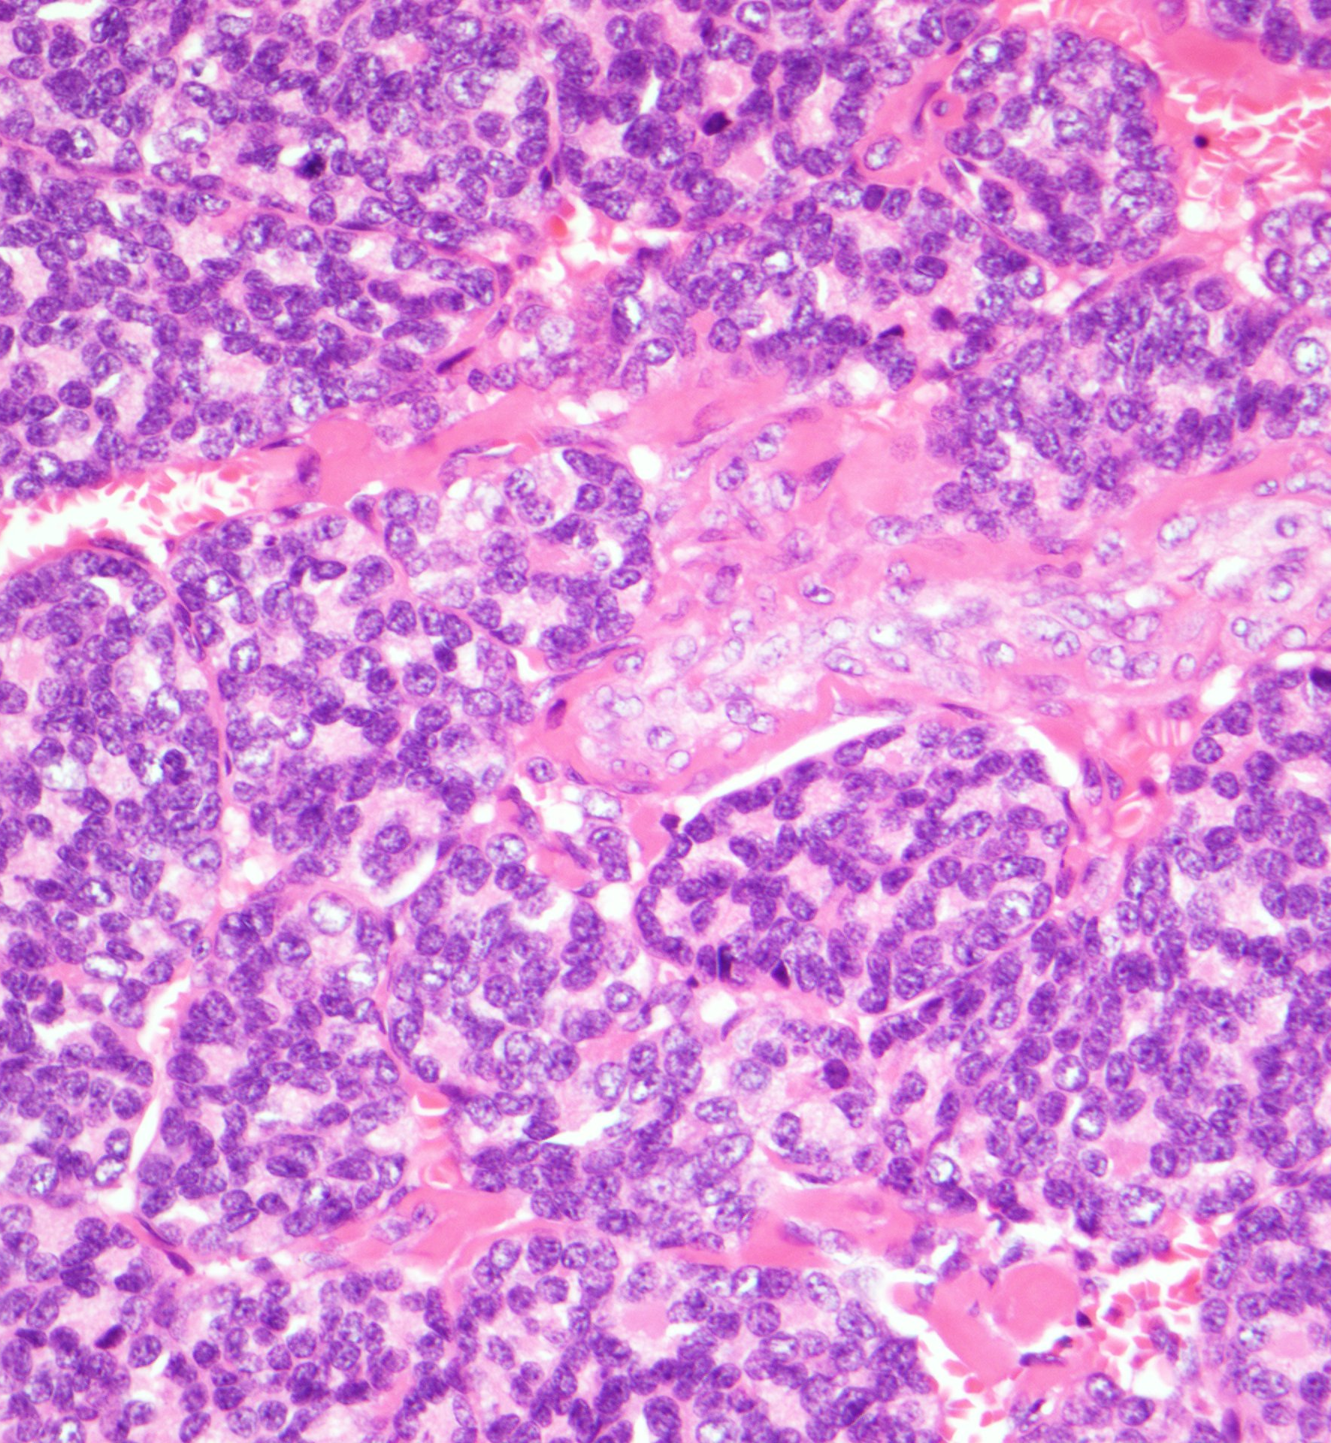
Fetal-type primitive-appearing thyroid follicles and fetal-type glands

Slide 61
PAX8
Desmin
Thyroglobulin

Slide 62
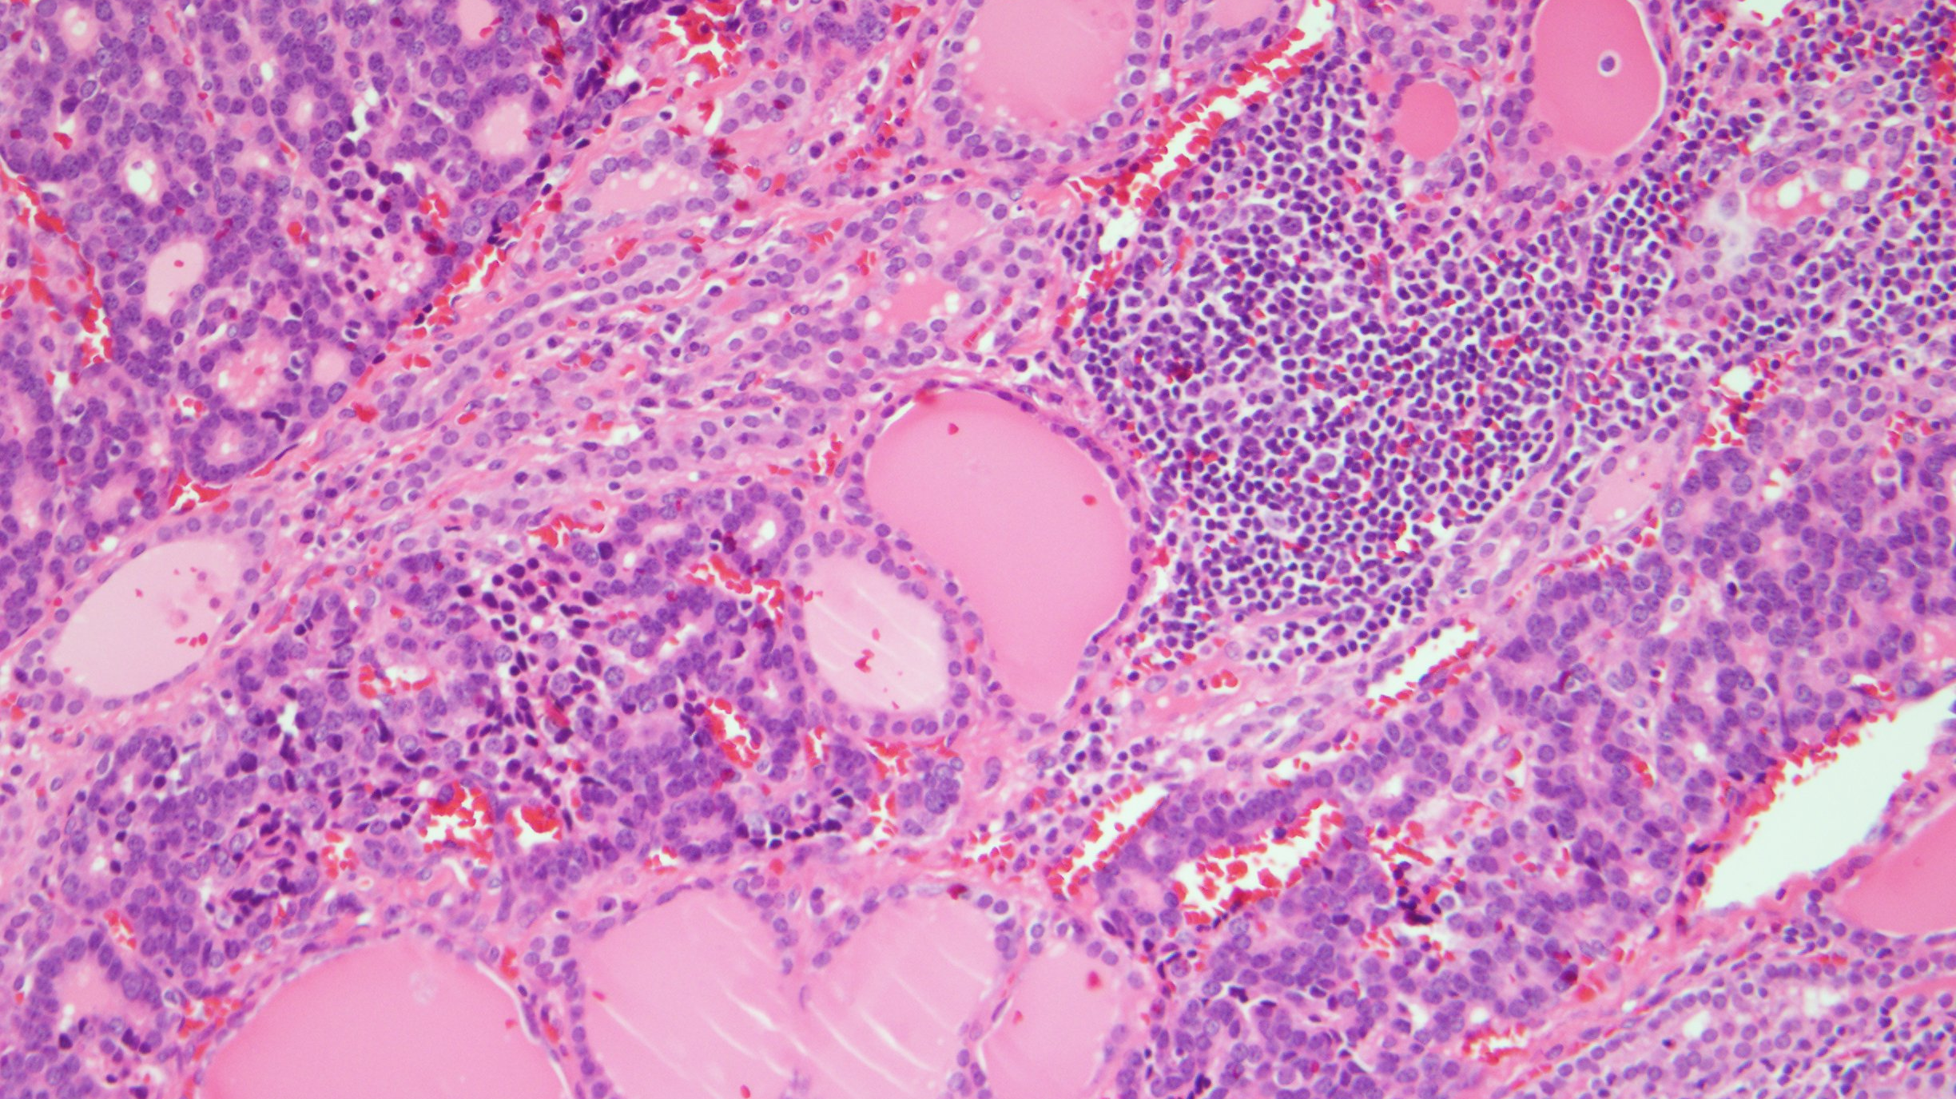

Slide 63
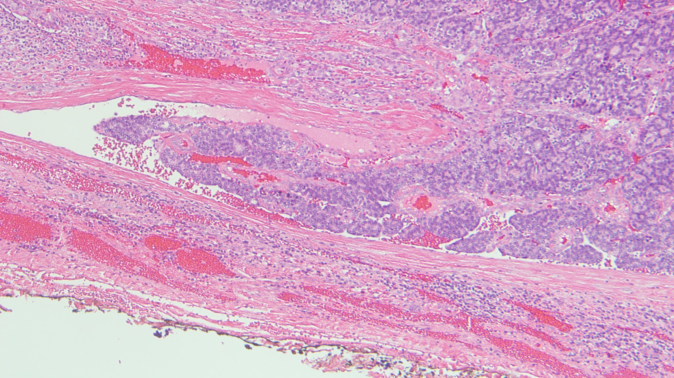
Vascular Invasion

Slide 64
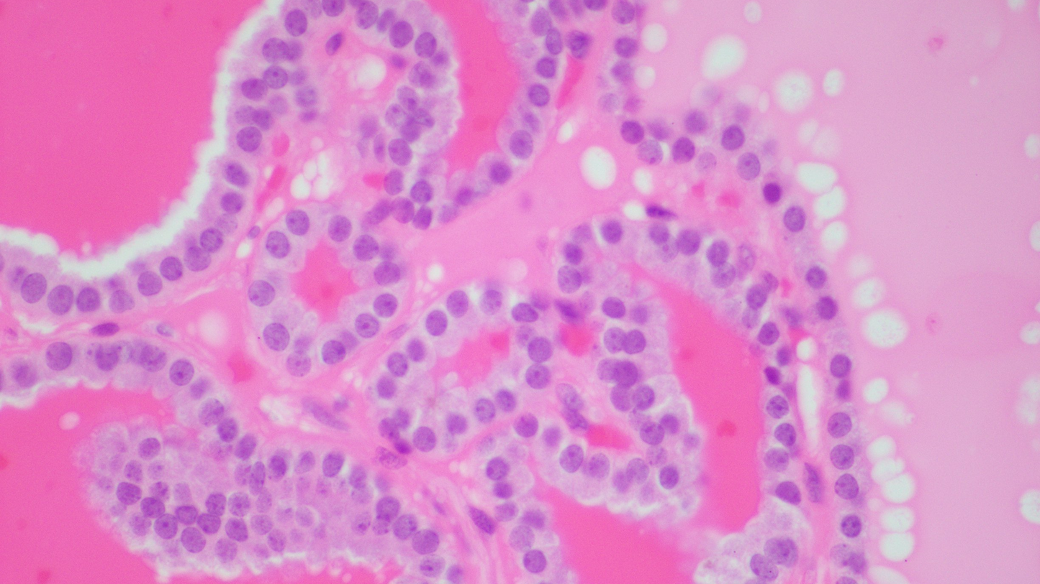
DICER1 Mutations:
Thyroid Pathology
Associated with DICER1 germline mutations, but also in patients with no known syndromic associations and in tumors with DICER1 somatic mutations
DICER1 is recognized to be a driver of pediatric thyroid nodules
Early-onset, familial, or male thyroid follicular nodular disease
Follicular adenomas with papillary growth
Differentiated thyroid carcinomas: follicular thyroid carcinoma and papillary thyroid carcinoma
Poorly differentiated thyroid carcinoma of childhood and adolescence
Thyroblastoma

Slide 65

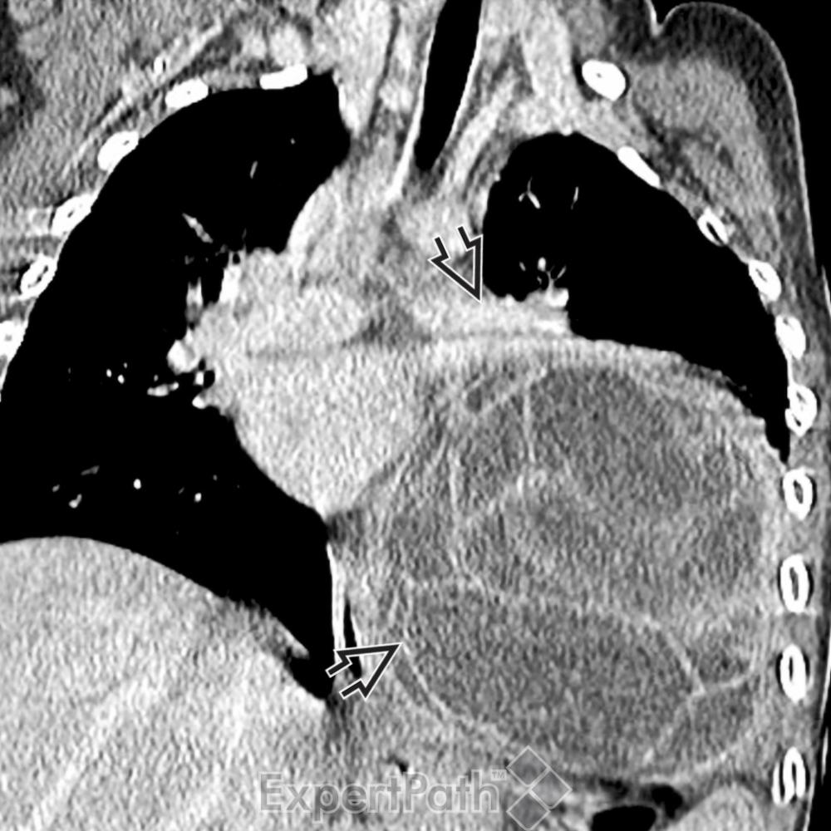
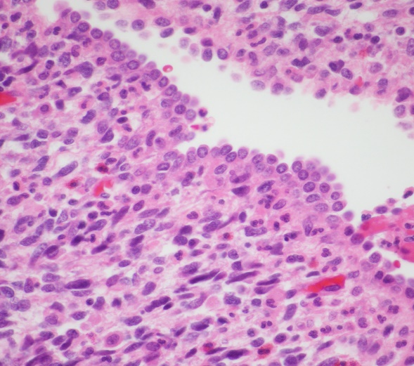
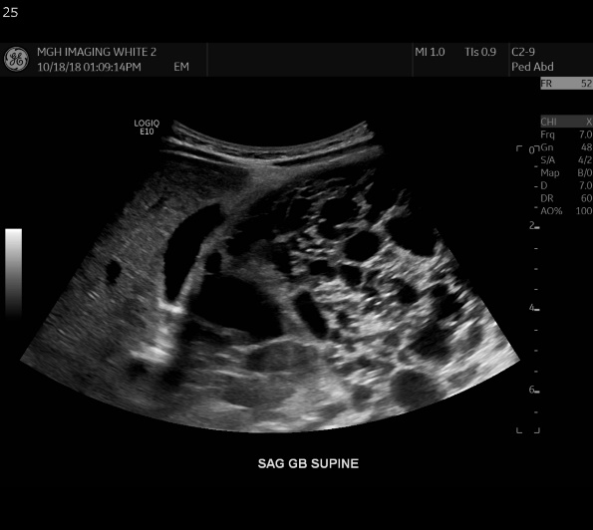
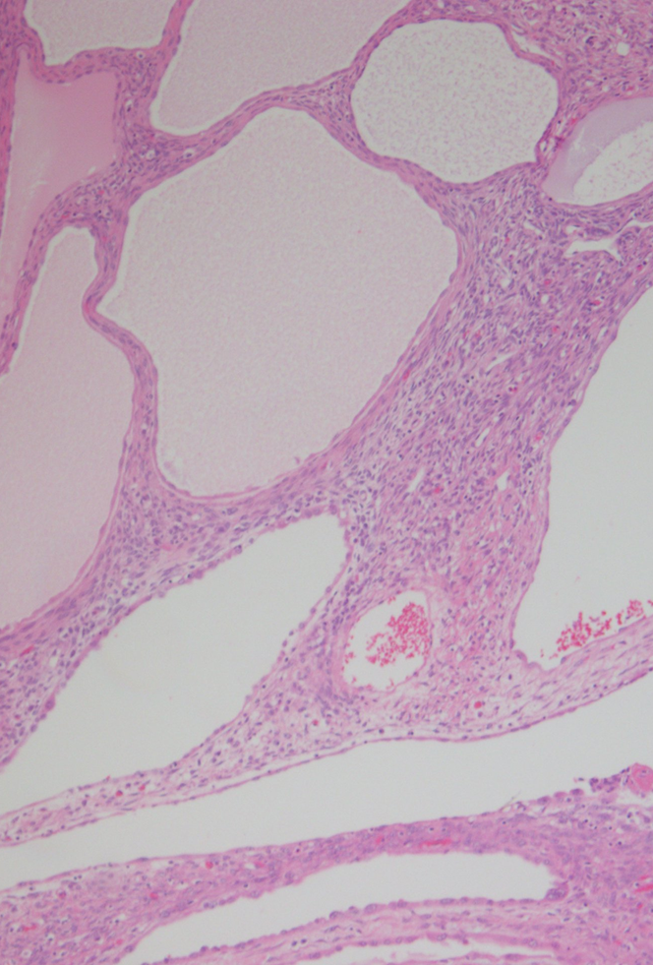
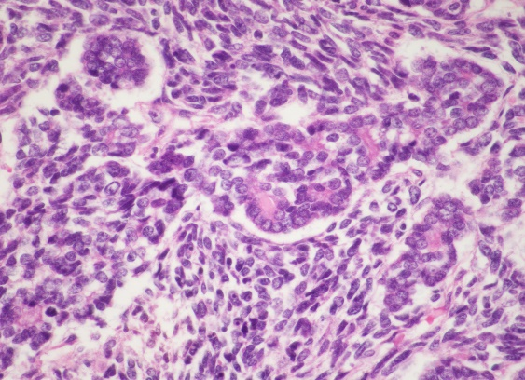
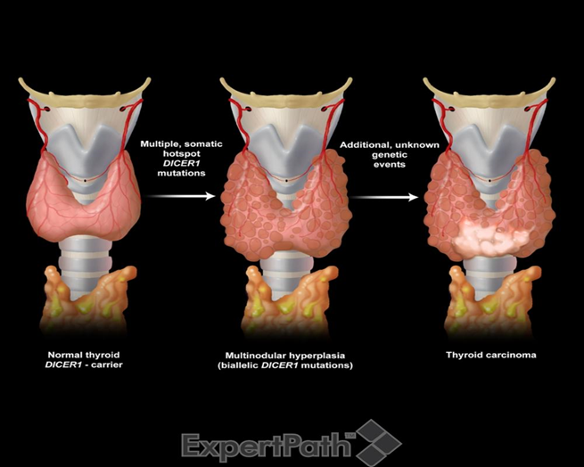

DICER1 Syndrome
Pleuropulmonary blastoma
Cystic nephroma
Ovarian Sertoli-Leydig Cell tumor
Gynandroblastoma
Pituitary blastoma
Pineoblastoma
Thyroid nodular follicular disease
Follicular adenoma with papillary hyperplasia
Thyroid carcinoma: PTC and FTC
Pediatric thyroid nodules
Childhood-onset PD thyroid carcinoma
Primitive thyroid tumor: Thyroblastoma
Many of these DICER1-associated neoplasms have some site dependent morphological resemblance to the developmental stages in organogenesis, resulting into a teratoid or blastomatous appearance

Slide 66

DICER1 Mutations and Thyroid Pathology
Follicular adenomas and differentiated thyroid carcinomas, as follicular thyroid carcinoma and papillary thyroid carcinoma, are associated with DICER1 germline mutations, but also in patients with no known syndromic associations and in tumors with DICER1 somatic mutations

Slide 67

Quantification of Thyroid Cancer and Thyroid Follicular Nodular Disease
Risk in the DICER1 Syndrome: A Family-Based Cohort Study
MNG might be the most penetrant phenotypic feature of DICER1 syndrome
16- to 24-fold increase in the risk of thyroid cancer compared with the expected incidence
They proposed a stepwise model in which benign nodules develop secondary to biallelic mutations in DICER1, and, over time, additional genetic mutations are acquired that prompt malignant transformation of these nodules
Observed a DICER1 germline mutation and a second, somatic hotspot DICER1 mutation in 16 of 19 sequenced benign thyroid nodules (84%)
J Clin Endocrinol Metab. 2017 May 1; 102(5): 1614–1622

Slide 68

Dicer 1 Syndrome:
Pathologists’ Roles
Early-onset, familial, or male thyroid follicular nodular disease should prompt a consideration of the presence of DICER 1 syndrome
Pathologists’ communication with clinicians with careful personal and family history focused on DICER1-associated tumors (especially PPB, CN, SLCT)
DICER1 carriers have significantly increased risk of thyroid follicular nodular disease compared with family controls and a significantly elevated risk of thyroid cancer compared with the population

Slide 69

What is New in Endocrine Tumor Syndromes
THE NEW: MEN4, MEN5, AND MAFA-RELATED FAMILIAL INSULINOMATOSIS
THE CLASSIC: SDH-DEFICIENT TUMOR SYNDROME
THE TRENDY: DICER1 SYNDROME AND RELATED TUMORS
THE REFASHIONED: FAP - CRIBRIFORM MORULAR THYROID CARCINOMA
THE ODD: NONSYNDROMIC FAMILIAL FOLLICULAR CELL–DERIVED THYROID TUMORS

Slide 70
Background
The familial development of some cancers was described more than a century ago
The number and knowledge of these syndromes have rapidly increased with the advent and widespread use of molecular diagnostics, which currently dominate clinical oncologic practice

Slide 71
2022 WHO Endocrine And Neuroendocrine Tumors:
15 Genetic Tumor Syndromes
1. Multiple endocrine neoplasia type 1
2. Multiple endocrine neoplasia type 2
3. Multiple endocrine neoplasia type 4 (CDKN1B)
4. Multiple endocrine neoplasia type 5 (MAX related tumours)
5.Hyperparathyroidism jaw tumour syndrome
6. Von Hippel Lindau syndrome
7. SDH deficient tumour syndrome
8. Neurofibromatosis type 1
9. Carney complex
10. McCune Albright syndrome
11. DICER1 syndrome
12. Glucagon cell hyperplasia and neoplasia
13. MAFA related familial insulinomatosis
14. Syndromic familial follicular cell-derived thyroid tumours
15. Non-syndromic familial follicular cell-derived thyroid tumours

Slide 72
Familial Thyroid Carcinoma
Familial Follicular Cell or Non-Medullary Thyroid Carcinoma: FNMTC
Further subdivided into 2 subgroups
Familial tumor syndromes characterized by predominance of nonthyroidal tumors
Familial tumor syndromes characterized by predominance of nonmedullary thyroid carcinoma
Familial Medullary Thyroid Carcinoma: FMTC
Occurs in 3 distinct settings
FMTC (medullary thyroid carcinoma-only syndrome)
Multiple endocrine neoplasia 2A (MEN2A)
Multiple endocrine neoplasia 2B (MEN2B)

Slide 73









Slide 74
Familial Thyroid Carcinoma

Slide 75
Non-Syndromic or Familial Tumor Syndrome with a Preponderance of NMTC
Most tumors are indistinguishable from sporadic
FNMTC know to be more aggressive
FNMTC has a high incidence of multifocality
Association with multiple benign nodules
Recurrence rates may be about twice as high for FNMTC as they are for sporadic NMTC
Shorter disease free survival
Notes:
Conclusion

Slide 76
FNMTC
To date, 4 susceptibility genes have been identified
  SRGAP1 gene (12q14)
  TITF-1/NKX2.1 gene (14q13)
  FOXE1 gene (9q22.33)
  HABP2 gene (10q25.3)]
  Only the FOXE1 and the HABP2 genes have been validated by separate study groups
The causal genes located at the other 7 FNMTC-associated chromosomal loci have yet to be identified
  TCO (19q13.2)
  fPTC/ PRN (1q21)
  FTEN (8p23.1-p22)
  NMTC1 (2q21)
  MNG1 (14q32), 6q22, 8q24

Slide 77





Slide 78




Slide 79


Follicular Cell Tumors: Summary
Sporadic follicular cell-derived carcinoma:
Usually single
Background thyroid normal
Familial follicular cell-derived carcinoma:
Single or multicentric
Background thyroid with lymphocytic thyroiditis and with other follicular cell neoplasms

Slide 80
Pathologists: Histopathological and Demographic Features Suggestive of Underlying Genetic Disease
1. Early onset or wrong age: Early onset of PTC
2. Wrong gender: Thyroid diseases in men
3. Bilateral: MTC
4. Specific histological pattern: Cribriform Morular Carcinoma
5. Genotype specific histology: PTEN-negative tumors
6. Multiple diverse lesions: PTEN, DICER1
7. Multifocal: Multiple thyroid tumors FNMTC
8. Precursor lesions: C cell hyperplasia/MTC
9. Specific combinations of tumors: PPB, CN, PTC

Slide 81
obrigadA

